Slide 1
Intro to compilers
Based on end of Ch. 1 and start of Ch. 2 of textbook, plus a few additional references

Slide 2
Announcements
Homework 1 due Wednesday
  Email pdf
  Or submit paper copy in class
Be sure to at least glance at syllabus, and send questions my way
No class Friday; instead, please read Chapter 2.1 of the textbook, and look at the first two pages of 2.2.

Slide 3
Compilation
The process by which programming languages are turned into assembly or machine code
  Central topic in programming languages
These are essentially translators, so they must semantically understand the code
Output: assembly, machine code, or some intermediate language
  (i.e. Java ->Bytecode)

Slide 4
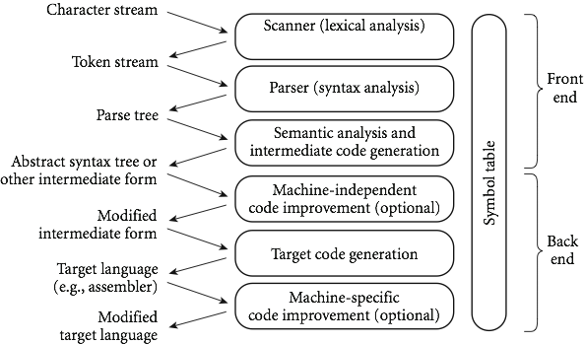
Compilation phases

Slide 5
Front end phases
The first 3 phases are known as the “front end”, where the goal is to figure out the meaning of the program
The last 3 are the “back end”, and are used to construct an equivalent target program in the output language
These are split to make things independent:
  The front end can be shared between different systems
  The back end can be shared between different source languages

Slide 6
First phase: scanning
Divides the program into "tokens", which are the smallest meaningful units; this saves time, since character-by-character processing is slow
We can tune the scanner better if its job is simple; it also saves complexity (lots of it) for later stages
You can design a parser to take characters instead of tokens as input, but it isn't pretty
Theoretically, scanning is recognition of a regular language, e.g., via a deterministic finite automata (or DFA)

Slide 7
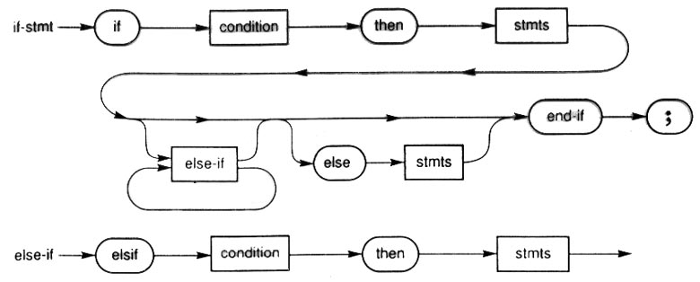
Phase 2: parsing
Parsing is recognition of a context-free language, done via something called a push down automata (or PDA)
  Parsing discovers the "context free" structure of the program
  Informally, it finds the structure you can describe with syntax diagrams

Slide 8
Phase 3: semantic analysis
Semantic analysis is the discovery of meaning in the program
  The compiler actually does what is called STATIC semantic analysis. That's the meaning that can be figured out at compile time
  Some things (e.g., array subscript out of bounds) can't be figured out until run time. Things like that are part of the program's DYNAMIC semantics

Slide 9
Phase 4: intermediate form
Intermediate form (IF) is done after semantic analysis (if the program passes all checks)
  IFs are often chosen for machine independence, ease of optimization, or compactness
    Note: these are somewhat contradictory!
  They often resemble machine code for some imaginary idealized machine; e.g. a stack machine, or a machine with arbitrarily many registers
  Many compilers actually move the code through more than one IF

Slide 10
Bottom phases
Optimization takes an intermediate-code program and produces another one that does the same thing faster, or in less space
  The optimization phase is optional, but is often key for speed
Code generation phase produces assembly language or (sometime) machine language

Slide 11
Bottom phases (cont)
Certain machine-specific optimizations (use of special instructions or addressing modes, etc.) may be performed during or after target code generation
Symbol table: all phases rely on a symbol table that keeps track of all the identifiers in the program and what the compiler knows about them
  This symbol table may be retained (in some form) for use by a debugger, even after compilation has completed

Slide 12
An Overview of Compilation
Lexical and Syntax Analysis: back to our GCD Program (in C)
int main() {
int i = getint(), j = getint();
while (i != j) {
  if (i > j) i = i - j;
  else j = j - i;
}
putint(i);
}
Copyright © 2009 Elsevier

Slide 13
An Overview of Compilation
Lexical and Syntax Analysis
  GCD Program Tokens
    Scanning (lexical analysis) groups characters into tokens, the smallest meaningful units of the program
        int main ( ) {
        int i = getint ( ) , j = getint ( ) ;
        while ( i != j ) {
        if ( i > j ) i = i - j ;
        else j = j - i ;
        }
        putint ( i ) ;
}
Copyright © 2009 Elsevier

Slide 14
An Overview of Compilation
Context-Free Grammar and Parsing
  Parsing organizes tokens into a parse tree that represents higher-level constructs in terms of their constituents
  Potentially recursive rules known as a context-free grammar define the ways in which these tokens can combine
Copyright © 2009 Elsevier

Slide 15
An Overview of Compilation
Context-Free Grammar and Parsing
  Example (while loop in C)
iteration-statement → while ( expression ) statement
statement, in turn, is often a list enclosed in braces:
statement → compound-statement
compound-statement → { block-item-list opt }
where
block-item-list opt → block-item-list
or
block-item-list opt → ϵ
and
block-item-list → block-item
block-item-list → block-item-list block-item
block-item → declaration
block-item → statement
Copyright © 2009 Elsevier

Slide 16
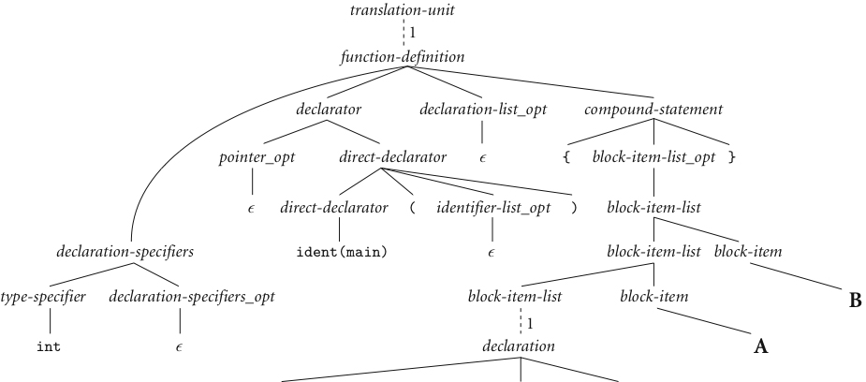
An Overview of Compilation
Example: Our GCD Program Parse Tree
B
A
Copyright © 2009 Elsevier
next slide

Slide 17
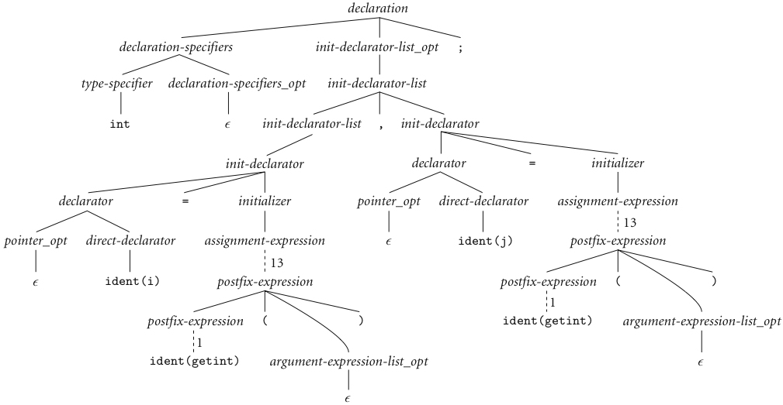
An Overview of Compilation
Context-Free Grammar and Parsing (continued)
Copyright © 2009 Elsevier

Slide 18
An Overview of Compilation
Context-Free Grammar and Parsing (continued)
A
B
Copyright © 2009 Elsevier

Slide 19
Ch. 2 – a deeper look
We’ll take a deeper look at scanning and parsing, the two parts of the “front end” of this process
Each has deeper ties to theoretical models of computation, and useful concepts like regular expressions
  You may have seen these if you’ve done string manipulations.

Slide 20
Regular expressions
A regular expression is defined (recursively) as:
  A character
  The empty string, ε
  2 regular expressions concatenated
  2 regular expressions connected by an “or”, usually written x | y
  0 or more copies of a regular expression – written *, and called the Kleene star

Slide 21
Regular languages
Regular languages are then the class of languages which can be described by a regular expression
Example: L = 0*10*
Another: L = (1|0)*

Slide 22
More regular languages
Exercise: Give the regular expression for the language of binary strings that begin with a 0 and end with a 1
Exercise (a bit harder): Give the regular expression for the language of binary strings that start with a 0 and have odd length

Slide 23
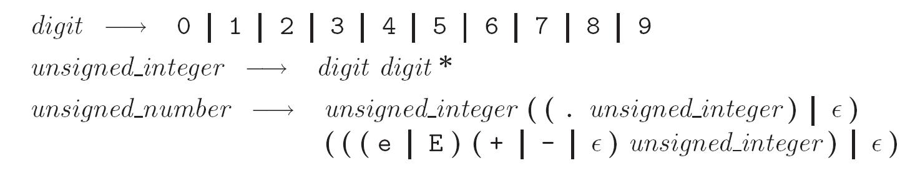
A more realistic example
Unsigned integers in Pascal:
  Examples: 4, or 82.3, or 5.23e-26
Formally:

Slide 24
Another view: DFAs
Regular languages are also precisely the set of strings that can be accepted by a deterministic finite automata (DFA)
Formally, a DFA is:
  a set of states
  an input alphabet
  a start state
  a set of accept states
  a transition function: given a state and input, outputs another state

Slide 25
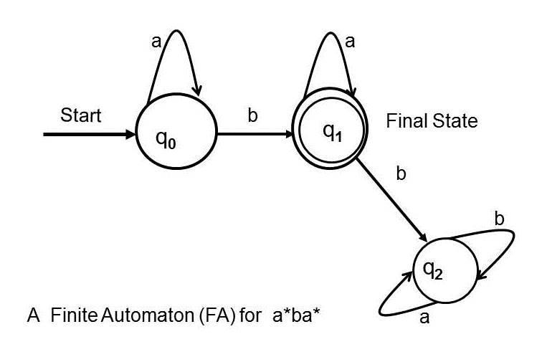
DFAs
More often, we’ll just draw a picture (like in graph theory)
Example:

Slide 26
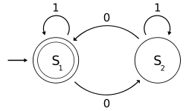
DFAs
What regular language does the following DFA accept?

Slide 27
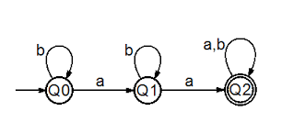
DFA examples
What’s the DFA for the regular language: 1(0|1)*0
What’s the regular language accepted by this DFA?

Slide 28
Scanning
Recall scanner is responsible for
  tokenizing source
  removing comments
  (often) dealing with pragmas (i.e., significant comments)
  saving text of identifiers, numbers, strings
  saving source locations (file, line, column) for error messages
Copyright © 2009 Elsevier

Slide 29
Scanning
Suppose we are building an ad-hoc (hand-written) scanner for Pascal:
  We read the characters one at a time with look-ahead
If it is one of the one-character tokens
{ ( ) [ ] < > , ; = + - etc }
we announce that token
If it is a ., we look at the next character
  If that is a dot, we announce .
  Otherwise, we announce . and reuse the look-ahead
Copyright © 2009 Elsevier

Slide 30
Scanning
If it is a <, we look at the next character
  if that is a = we announce <=
  otherwise, we announce < and reuse the look-ahead, etc
If it is a letter, we keep reading letters and digits and maybe underscores until we can't anymore
  then we check to see if it is a reserve word
Copyright © 2009 Elsevier

Slide 31
Scanning
If it is a digit, we keep reading until we find a non-digit
  if that is not a . we announce an integer
  otherwise, we keep looking for a real number
  if the character after the . is not a digit we announce an integer and reuse the . and the look-ahead
Copyright © 2009 Elsevier

Slide 32
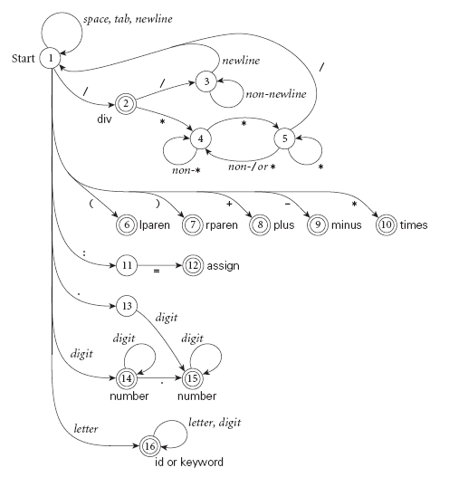
Scanning
Pictorial representation of a scanner for calculator tokens, in the form of a finite automaton
Copyright © 2009 Elsevier

Slide 33
Coding DFAs (scanners)
That’s all well and good – but how to we program this stuff?
  A bunch of if/switch/case statements
  A table and driver (flex or other tools)
Both have merits, and are described further in the book.
We’ll mainly use the second route in homework, simply because there are many good tools out there.

Slide 34
Scanners
Writing a pure DFA as a set of nested case statements is a surprisingly useful programming technique
  though it's often easier to use perl, awk, sed
  for details see Figure 2.4 in text
Table-driven DFA is what lex and scangen produce
  lex (flex) in the form of C code – this will be an upcoming homework
  scangen in the form of numeric tables and a separate driver (for details see Figure 2.12)

Slide 35
Next week
We’ll see a bit more about DFAs, and introduce NFAs.
  This is the rest of section 2.2, if you want to look ahead a bit.
By the end of the week, we’ll move to discussing one table-driven DFA, flex, and have the first programming assignment over it the week after.

