Slide 1
More on scanning: NFAs and Flex

Slide 2
Last time
Scanners: the first step in compilation
  Divides the program into tokens, or smallest meaningful units
  This makes later parsing much simpler
Theory end of things: tokenizing is equivalent to specifying a DFA, which recognizes a regular language

Slide 3
Regular expression recap
Write a DFA that recognizes any 0,1 string that has the number of 0’s in the string equal to 0 mod 3:

Slide 4
NFAs
Nondeterministic finite automata (NFA) are a variant of DFAs.
DFAs do not allow for any ambiguity:
  if a character is read, there can only be 1 arrow showing where to go
  No empty string transitions, so must read a character in order for the transition function to move to a new state
If instead we have multiple options, it is called an NFA

Slide 5
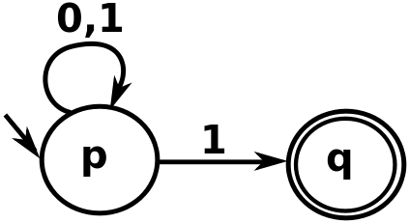
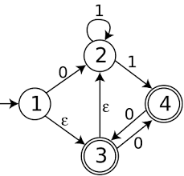
NFA Examples
What do the following NFAs accept?

Slide 6
More NFAs
Some things are easier with NFAs than DFAs:
unsigned_number -> unsigned_int (ε | .unsigned_int)
unsigned_int -> [0-9]

Slide 7
NFAs
Essentially, when parsing a stream of characters, we can think of an NFA as modeling a parallel set of possibilities
Theorem: Every NFA has an equivalent DFA.
(And so both recognize regular languages, even though NFAs seem more powerful.)

Slide 8
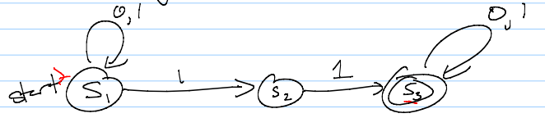
Converting NFAs to DFAs
To convert, mimic set of possible states given an input
A state is an accept state if any state in it is an accept state – that means the string could have ended in an accept state, and so is in the language

Slide 9
Why do we care?
You may ask: why do we care about NFAs?
Well, in terms of defining a parser, we usually start with regular expressions.
We then need a DFA (since NFAs are harder to code).
  However, getting from a regular expression to a DFA in one step is difficult.
  Instead, programs convert to an NFA, and THEN to a DFA.
  Somewhat un-intuitively, this winds up being easier to code.

Slide 10
Constructing NFAs
The construction process for NFAs is pretty easy.
Recall how a regular expression is defined:
  A single character or ε
  Concatenation
  An “or”
  Kleene star
So all we need to do is show how to do each of these in an NFA (and how to combine them)

Slide 11
Constructing NFAs
Easy first step: What is the NFA for a single character, or for the empty string?
Now: what if I have NFAs for 2 regular expressions, and want to concatenate?

Slide 12
Constructing NFAs
A bit harder: what about an “or” or Kleene star?

Slide 13
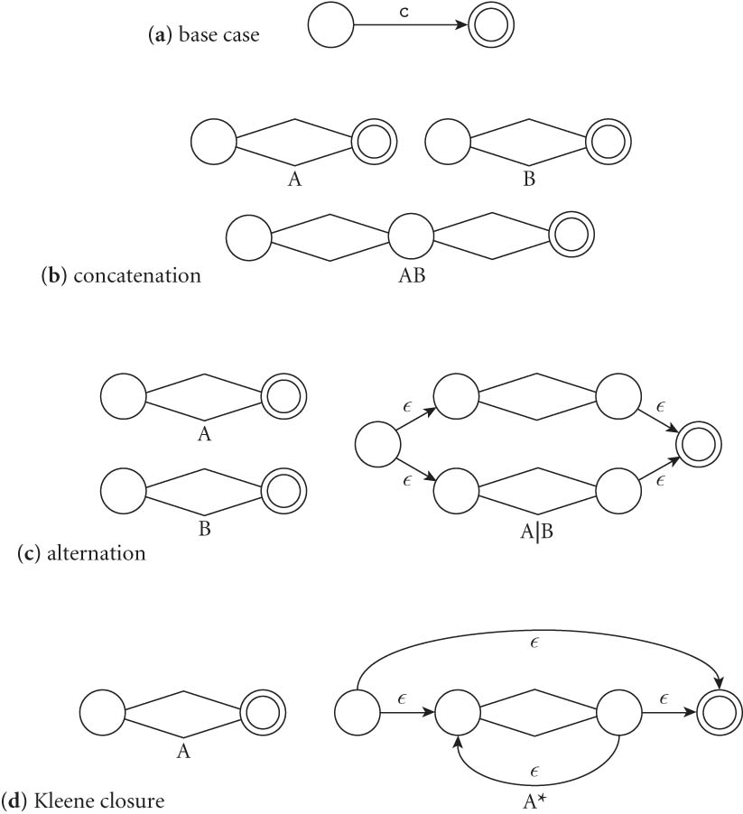
Constructing NFAs
Final picture (2.7 in book):

Slide 14
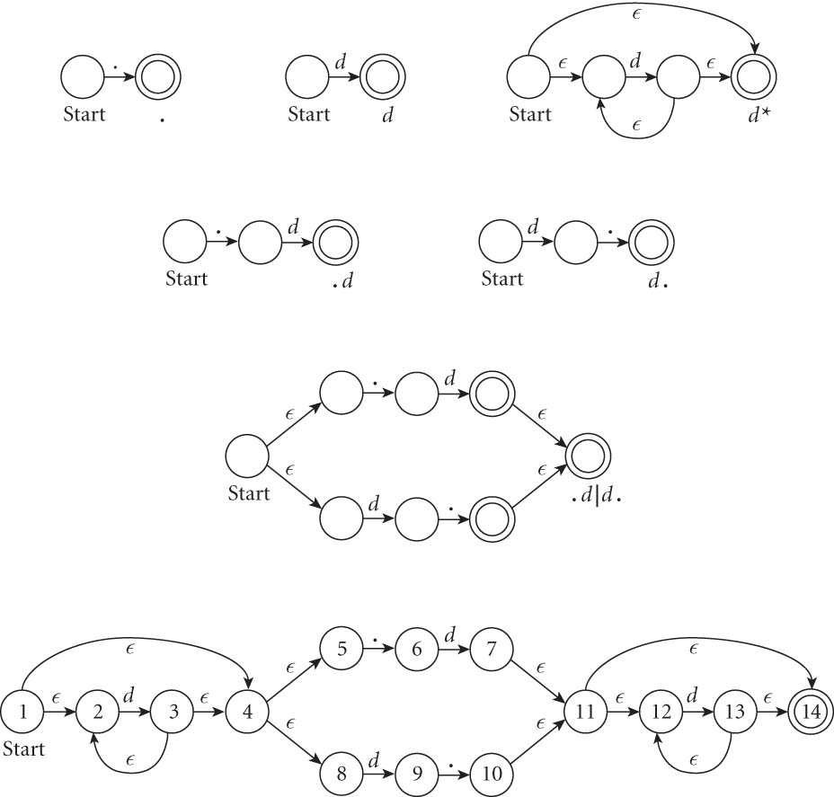
An example: decimals
Let d = [0-9], then decimals are: d* (.d | d. ) d*

Slide 15
From NFAs to DFAs
Next, a scanning program needs to go from this NFA to a DFA
  Mainly because “guessing” the right transition if there are multiple ones is really hard to code
  Much easier to convert to DFA, even though it can get bigger.
  (Side note: how much bigger?)

Slide 16
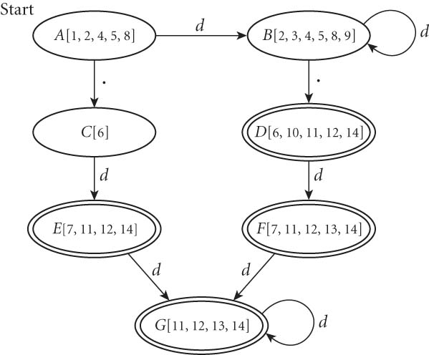
From NFAs to DFAs
If we automate this conversion on our last NFA (of decimals), we get:

Slide 17
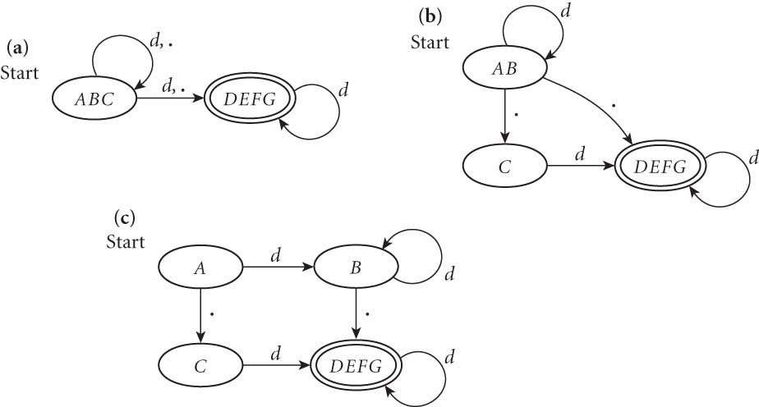
Minimizing DFAs
In addition, scanners take this final DFA and minimize.
  (We won’t do this part by hand – I just want you to know that the computer does it automatically, to speed things up later.)

Slide 18
Coding DFAs (scanners)
So, given a DFA, code can be implemented in 2 ways:
  A bunch of if/switch/case statements
  A table and driver
Both have merits, and are described further in the book.
We’ll mainly use the second route in homework, simply because there are many good tools out there.

Slide 19
Scanners
Writing a pure DFA as a set of nested case statements is a surprisingly useful programming technique
  though it's often easier to use perl, awk, sed
  for details see Figure 2.11
Table-driven DFA is what lex and scangen produce
  lex (flex) in the form of C code – this will be an upcoming homework
  scangen in the form of numeric tables and a separate driver (for details see Figure 2.12)

Slide 20
Limitations of regular languages
Certain languages are simply NOT regular.
Example: Consider the language 0^{n}1^{n}
How would you do a regular expression of DFA/NFA for this one?

Slide 21
Beyond regular expressions
Unfortunately, we need things that are stronger than regular expressions.
A simple example: we need to recognize nested expressions
expr -> id | number | -expr |
(expr)| expr op expr
op -> + | - | * | /
Regular expressions can’t quite manage this, since could do ((((x + 7) * 2) + 3) - 1)

Slide 22
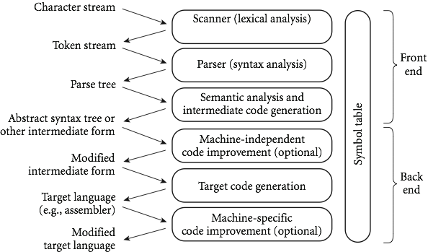
Next time
Flex, a c-style scanner
Later this week: parsing and CFGs, which are stronger than DFAs/scanning

