Slide 1
Network security
BGP and DNS
Worms

Slide 2
BGP: Border Gateway Protocol
Designed in 1989 as a way for autonomous systems (AS) – usually routers - to exchange routing info
  Sometimes external versus internal is distinguished
BGP neighbors (or peers) are established manually between routers – TCP on port 179
A 19-byte message is sent every 30 seconds to maintain the connection

Slide 3
How BGP works
An AS notifies everyone else what networks belong to it, and how to direct traffic correctly
Based on netblocks:
  192.169.0.0/24: all addresses between 192.169.0.0 and 192.169.0.255
  192.169.4.0/22: all addresses between 192.169.4.0 and 192.169.7.255
If an AS is responsible for a netblock, it advertises this to neighbors
If an AS is willing to provide transit for another AS, it advertises this as well
If an AS sees multiple advertisements, it tries to choose the most specific or “shortest path”

Slide 4
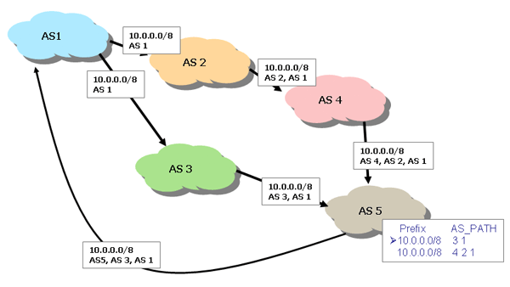
Setup for BGP
An example:

Slide 5
BGP Blackhole attack
First, get labeled as an AS peer by someone
  Not too hard
Then advertise a more specific route:
  Example: If your victim is 192.169.2.34 in a /16 netblock, advertise a route for 192.169.2.0/24
  Your route will take precedence
Even if there is a tie, you can still capture or deny traffic for Ass closer to you than your victim, since BGP defaults to shorter path

Slide 6
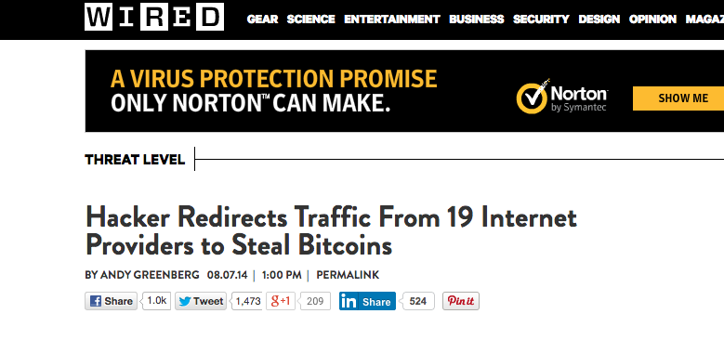
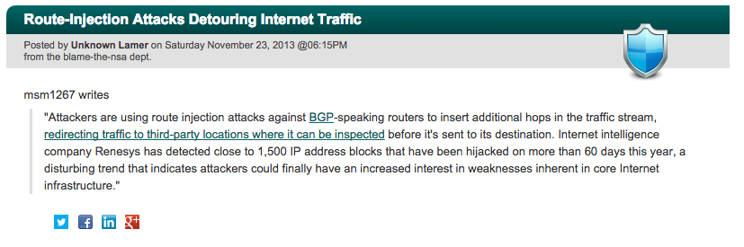
BGP Blackhole attacks
These actually happen! (Rather often…)

Slide 7
Fixing it
Resolution of these hacks isn’t easy
  Human mediated detection and response: Find the upstream point of the bad AS and get them to stop accepting this route along the way.
All ASs must trust neighbors, which trust their neighbors, etc – so only takes one malicious AS to break it.
  In other words, trust in this system is transitive and global, and any such system can be hacked!

Slide 8
Blackhole purposes
One bright side – this only allows denial of service, not compromise of system
Generally doesn’t last long either, since people notice when their traffic drops
RouteViews or similar tools can help find offenders
However, can happen by a screwup rather than by malice

Slide 9
Using blackhole for man-in-the-middle
The Polokov Attack (performed live at DEFCON 2008):
  Have two connections to the internet – one with full peering connection (the attack link) and one that doesn’t filter packets by IP address (the return link)
  Through the return link, perform a traceroute to victim’s network, and compute the AS path for this route (the return path)
  Through the attack link, advertise your victim’s network (as a blackhole), but prepend the return AS path
  Result: all BUT the return AS path will direct traffic to you!
  Then modify the packets, so when one is going to the victim, increment the TTL field and forward it through the return link

Slide 10
General countermeasures for Blackhole attacks
Monitor (via routeview services that are easy to get) remote BGP feeds
  If your network isn’t behaving, alert someone!
  Small community, so usually easy
  However, not instantaneous fix
A lot of work has focused on cryptographic authentication to verify ownership
  Problem: BGP thrives on flexibility
  Another: Routers aren’t flexible, and crypto overhead isn’t negligible

Slide 11
DNS
The Domain Name System (DNS) is the distributed system for mapping user friendly domain names (such as google.com or mathcs.slu.edu) to the correct IP addresses.
It is hierarchical:
  Authoritative name servers “own” a domain
  These govern which servers “own” subdomains
Invented in 1983 by Paul Mockapetris; prior to this every computer simply had a file called hosts.txt that stored all computers on the ARPANET.

Slide 12
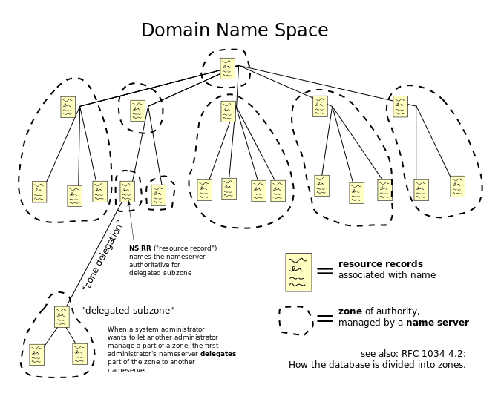
How it works:

Slide 13
More DNS details
DNS is generally udp based (so not terribly reliable).
To reduce the load on the system, records are cached for some period of time; this is generally a small amount of time, but the protocol supports up to 68 years.
The OS of any computer runs a DNS resolvers that applications hand requests to.
In addition, home users are relying on ISPs setting up a DNS server to track their current IP.
Things can be even more complex; some applications (such as web browsers) even keep their own DNS cache.

Slide 14
DNS details (cont.)
Hostnames and IPs don’t necessarily match 1-1.
  For example, often set up a domain name with multiple IPs in order to distribute traffic load.
Also used for email delivery.
Multiple servers are generally provided for each domain to deal with any failures in the system.
Variants such as dynamic DNS (DDNS) allow for rapid update by the hosts (such as for mobile systems).

Slide 15
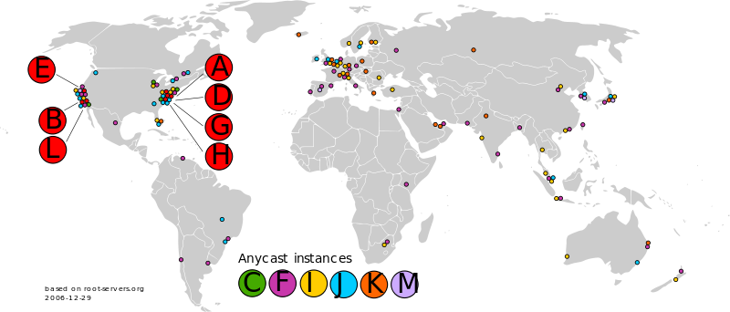
Root servers
At the top level, there are 13 root servers (A-M) somewhere in the world, with additional scattered backups.

Slide 16
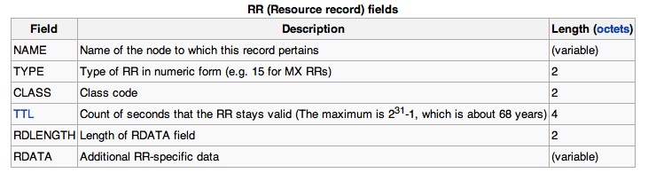
DNS resource records
The data structure that holds the information is called a resource record (often abbreviated RR).
Contains:

Slide 17
DNS and security
DNS lookups are inherently not secret or secure.
Nothing guarantees information integrity in this system.
  This is a problem – the internet depends on this process working correctly!
Obvious availability issues, since these servers going down would disrupt service worldwide.
The server or client could be a threat, since nothing is authenticated in this system.

Slide 18
DNS lookup problems
What can really go wrong?
A DNS answer (coming from a server) could be spoofed by a malicious user.
  Relatively easy – it’s UDP, remember?
  Combine with injection attack – send request so server will check, and at the same time flood with your own answer.
A DNS server could actually send false data.
DNS databases could be corrupted.

Slide 19
How likely?
Important names (ie TLD: .gov, .com, etc.) generally have a long TTL field.
Attacks can only be attempted once per TTL, so how likely?
  An attacker can send 1000 packets in an attempt. Odds of success are 1 – (1-2⁻¹⁶)¹⁰⁰⁰ ~ 1.5%
  (Not that comforting, actually…)

Slide 20
One defense: increase entropy
Instead of always using the same UDP source port, select a random one.
  Now attacker has to guess both transaction ID and the source port, so 1 in 2³⁰ instead of 1 in 2¹⁶ per packet.
Also, DNS is case insensitive, but almost all authorities preserve case (lazy programming)
  So randomly apply a capitalization

Slide 21
DNSSec: one solution
The basic concept of DNSSEC is simple – all transactions are “signed” so that you know the correct source is giving you the data.
Two options:
  The server responding can “sign”
  Or the server that owns the namespace can “sign”
DNSSEC has the server that owns the namespace sign the authenticity of any RR’s giving an address.
Note: not a privacy solution!

Slide 22
Practical implications to DNSSEC
Each DNS database must store signatures for RR’s.
  Essentially adds several portions to the RR’s, including DNSKEY, RRSIG, etc.
  The records have gotten much longer as a result.
ICANN (which manages DNS) signs for itself and top level domains.
Each top level domain signs for domains under it.
And so on down.

Slide 23
An example
Consider mathcs.slu.edu (or 165.134.234.6). Who signs this translation?
The SLU DNS server
And how can we be sure that that is the correct server to sign?
Because the EDU server verifies the SLU server’s signature
Each level leads one step closer to top level ICANN server, and this information lives in DNS databases.
Ideally, every query will begin at the top, so entire chain is authenticated.

Slide 24
Some problems
To use DNSSEC, it must be supported by the DNS server above you (as well as all the others above that).
If no RRSIG comes back in the RR, it could be an error. Or a man-in-the-middle attack. Or a configuration problem along the way.
To be secure, need to check all signatures yourself, but also can have trusted authority check them (and to have secure communication between yourself and authority).

Slide 25
Non-existent records
How can we get a signed record for EVERY possible non-existent name out there, to be sure they actually don’t exist?
Solution: Names are alphabetically ordered. Between any two names, a bunch don’t exist, so we can sign this range of names.
When someone looks up one of these names, we give them a range signature.

Slide 26
For Example
lasr.cs.ucla.edu
131.179.192.136
You get authoritative information that the name isn’t assigned
pelican.cs.ucla.edu
lbsr.cs.ucla.edu –
pd.cs.ucla.edu
131.179.128.17
NOT ASSIGNED
toucan.cs.ucla.edu
131.179.128.16
pelican.cs.ucla.edu
131.179.128.17
toucan.cs.ucla.edu
131.179.128.16
Foils spoofing attacks
> host last.cs.ucla.edu

Slide 27
DNSSEC status
Implementations of DNSSEC are in use, and are heavily promoted (first by DARPA and now by DHS).
ICANN has signed the root, and all the major nodes are done (.com, .gov, .edu, .org, .net)
NOT all signed below, however, and many “island of security” exist in DNS.
  These sign for themselves and anyone below.
The utility of DNSSEC ultimately depends on the clients actually checking signatures.

Slide 28
Using DNSSEC
Unfortunately, installing and managing DNSSEC is also fairly difficult.
  Particularly hard for domains with lots of things to support, since every new name required lots of new things to sign.
In practice, many things sign certificates for lengthy amounts of time (days or months), which makes hijacking after an update much easier, also.

Slide 29
Privacy
Obviously, DNSSEC does nothing to keep communication secret. DNS is inherently public!
Encryption is the core of how we keep communication secret. So what else should we worry about?
Traffic analysis:
  Sometimes, the goal is to hide that we are even talking to each other.
  This can be deduced even if our data is encrypted, since routing is a public process.

Slide 30
Location Privacy
In addition to knowledge of communication, location information is given away by packet data.
  IP addresses often give away a lot of information about where you are.
Mobile devices communicate while you are on the move!
  Can be used to get information on our movement and actions, often without our knowledge.
What types of solutions are possible today, given our internet infrastructure?

Slide 31
Anonymizer
Network sites that accept requests from outsiders.
  They submit these requests under their own or a fake identity.
  Responses are returned to the original requester.
  In fact, a NAT box is a simple version of this!
Problem:
  The anonymizer knows your identity.
  Generally, should not assume this is a reliable source of anonymity, since can be tricked, hacked, or compelled into giving up information.

Slide 32
Onion Routing
Meant to conceal sources and destinations in all traffic.
  A group of nodes agree to be onion routers.
  The users obtain cryptographic keys for those nodes.
  Each packet goes through many hops.
  Many users send many packets through the routers, which conceals who is really talking to whom.
Setup for a packet:
  Encrypt the packet with the destination’s key.
  Wrap that with another packet to another router, encrypted with that router’s key.
  Iterate this many times.

Slide 33
A picture:
Source
Destination
Onion routers

Slide 34
What’s Really in the Packet

Slide 35
Delivering the Message

Slide 36
What do we get?
Assuming it all went right:
Nobody could read our data.
Nobody is sure who sent it (except the receiver).
Nobody is sure who received it (except the sender).

Slide 37
Onion routing issues
Using keys properly
Traffic analysis is still possible
Overhead is a problem
  Multiple hops
  Multiple encryptions
Limited anti-government possibilities. (In particular, China has a history of disabling these.)
Ethical implications, also.
  This makes running botnets much easier.

