Slide 1
Tools for secure coding
Fuzzing
SQL Injections

Slide 2
Recap
Code vulnerabilities:
  Buffer overflows
  String formatting
  Overflow
Last time: runtime detection
  Bounds checking
  Stackguard (for some types of attacks)
  Randomization and canaries

Slide 3
Challenge
A significant amount of testing is done, but in general, people care more about features then security
  Until something breaks
How many lines of code do we really have to check? (“OMG PDF WTF”, Julia Wolf 2010)
  Linux 2.6.32: 8-12 million
  Windows NT 4: 11-12 million
  Adobe Acrobat: 15 million

Slide 4
0-days
A hacker’s obsession:
  A vulnerability that is not publically known
  Often combine multiple attack vectors and vulnerabilities into one exploit
  Can be open for months
These are actually sold
  Much controversy here – see the zero day initiative
But aren’t always necessary!
  Many security flaws are out there.

Slide 5
Finding bugs
A number of different tools and techniques
Static analysis is simply looking at the code and the system
  Often called source code auditing
Dynamic evaluation looks at the system while it is running
  Using a debugger or other tool
Often a combo is used, since neither is perfect

Slide 6
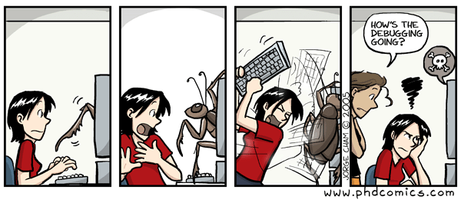
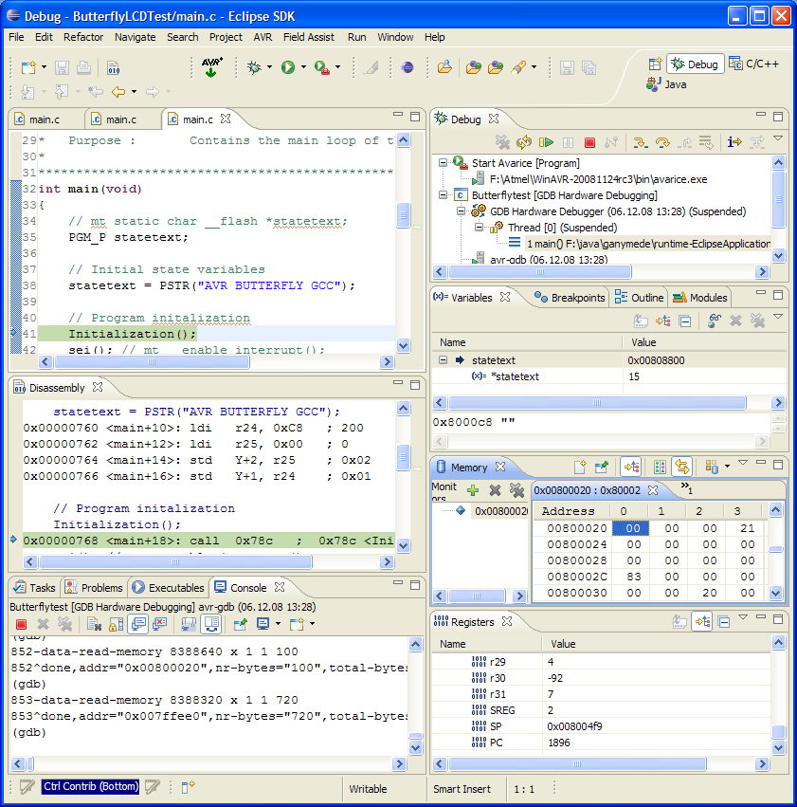
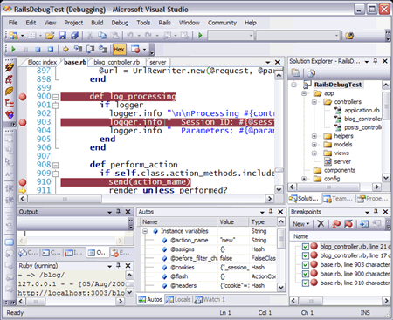
Debugging
Something we’re all (??) familiar with

Slide 7
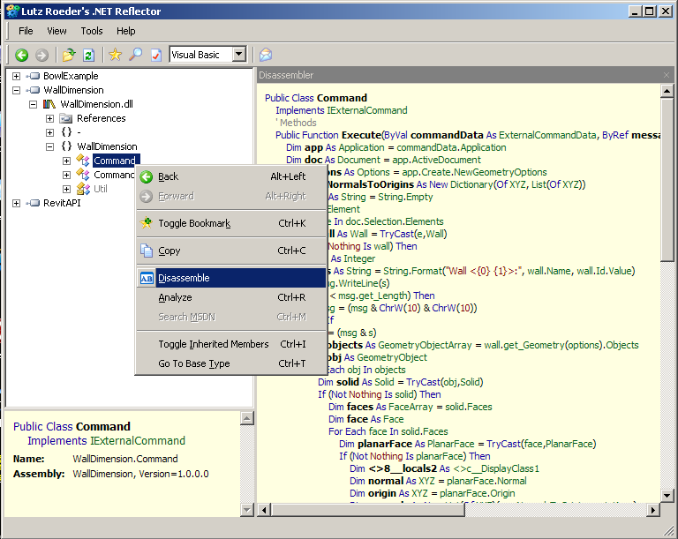
Reverse engineering
Decompilation: return code to programming-level language
  (Not necessarily the one you began with)
  Less successful in some cases

Slide 8
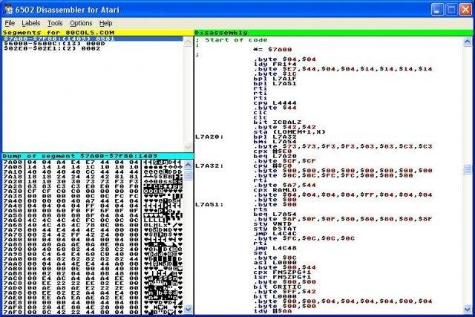
Reverse engineering
Disassembly: taking executable code back to assembler code
  Many commercial ones – an older area
Protocol reverse engineering:
  Big for secretive protocols, e.g. CSS

Slide 9
Regression analysis
Goal is to run on as many normal inputs as possible
  (Easier in engineering mentality)
This is a part of the design process everywhere
However, doesn’t always catch the odd errors or requests, since fundamentally we are checking that is it working, not how to break it.

Slide 10
Fuzzing
Whenever an application gets input, there is always a possibility of introducing malicious code
  These points are called the attack surface.
Fuzzing is a means of automating the injection of unexpected input
  Repeatedly run the program with many different inputs, recording crashes and error messages
  Often developed for specific programs, protocols, or formats
    Web-based
    File based

Slide 11
Trivial example
Standard HTTP GET request:
  GET /index.html HTTP/1.1
Essentially, a “verb” that describes an action, plus optional arguments that modify that verb
Several possible methods:
  GET, POST, PUT, DELETE, OPTIONS, CONNECT, HEAD, and TRACE
  Other legal possibilities, because HTTP allows new ones to be added

Slide 12
Anomalous requests
Various options to detect different errors:
  AA…AAA /index.html HTTP/1.1
  GET ///////index.html HTTP/1.1
  GET %n%n%n%n%n%n.html HTTP/1.1
  GET /AAAAAAAAAA.html HTTP/1.1
  GET /index.html HTTTTTTTTP/1.1
  GET /index.html HTTP/1.1.1.1.1.1.1
Essentially, hunting for overflows or other errors

Slide 13
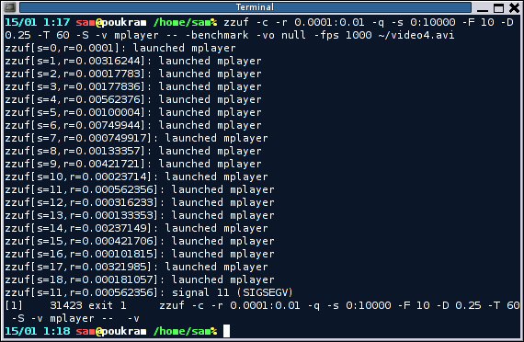

Mutation based fuzzing
Mutation based: take a well formed input, and randomly permute
Don’t need much knowledge of input structure
  May fail some protocols that have challenge/response format
Tools: ZZUF

Slide 14
Example: pdf viewer
Google for pdf
Crawl results and build a set of samples
Use tool to:
  Grab file
  Mutate it
  Feed to the program
  Record if crashed

Slide 15
Generation based fuzzing
Test cases are made from description of the format, such as documentation, RFC, etc.
Anomalies then can be added into any possible spot in the input
  More like my GET example earlier
In general, better results than random, since the knowledge of the protocol is built in
  But requires user to have that knowledge

Slide 16
Tools for generation based fuzzing
Many popular ones
Example: Spike
  Allows some automated tested of common fuzzing bugs
  Basically a C API
  Data structure is a SPIKE
  SPIKE utility routines make dealing with binary data, network code, and common marshalling routines easy
  SPIKE fuzzing framework automates iterating through all potential problem spots

Slide 17
Fuzzing Framework SPIKE calls
s_string_variable(“”);
s_string_repeat(“A”,5000);
  Equivalent to s_push("perl -e 'print “A” x 5000’”)
While loop support
  s_incrementfuzzstring();
  s_incrementfuzzvariable();
Uses same set of fuzz strings to locate common web server overflows, format string bugs, etc

Slide 18
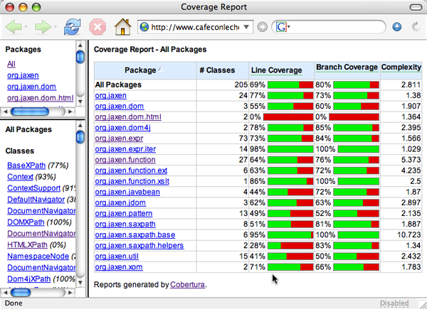
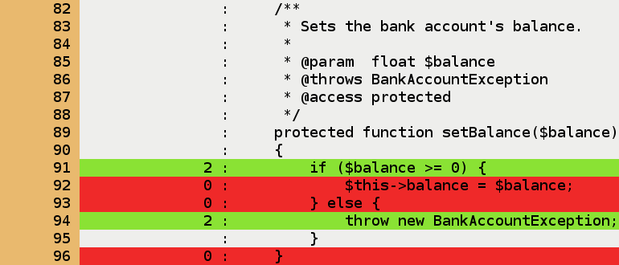
When is enough?
Code coverage is the question of how much code has been tested or executed.
Profiling tools exist for this in almost every language, with numerous metrics tested or examined.

Slide 19
Types of code coverage
Line/block coverage
  Measures how many lines of source code have been run
Branch coverage
  How many branches in code have been covered (conditional jumps)
Path coverage
  How many different paths have been taken

Slide 20
Simple example
if (a > 2)
a = 2;
if (b > 2)
b = 2;
Requires:
  1 test case for line coverage
  2 test cases for branch coverage
  4 test cases for path coverage

Slide 21
Code coverage tradeoffs
Benefits
  Tells you if getting stuck somewhere
  Might indicate benefits from different types of fuzzers, as well as comparisons
Problem:
  Code can be covered but not reveal bugs!

Slide 22
Injection attacks
A family of bugs that generally arise from unsanitized inputs being accepted
  SQL injections
Related:
  XSS: cross site scripting
  HTTP response splitting

Slide 23
SQL Injection
One of the most common types, simply because databases running on webservers are one of the most common things out there!
Based on how SQL works as a language
Basic SQL:
  Set of statements to interact with a database:
    SELECT, DELETE, INSERT, etc.

Slide 24
Simple example
CREATE Table Cities
{
CityID INT,
CityName VARCHAR(200),
State VARCHAR(200)
}
Creates a simple table, which you can then interact with via SQL statements.

Slide 25
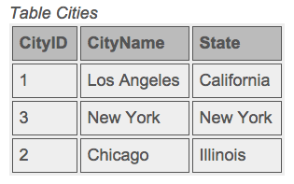
SQL Example
INSERT INTO Cities (CityID, CityName, State) VALUES (1, ‘Los Angeles’, ‘California’)
INSERT INTO Cities (CityID, CityName, State) VALUES (2, ‘New York’, ‘New York’)
INSERT INTO Cities (CityID, CityName, State) VALUES (3, ‘Chicago’, ‘Illinois’)
(You can then use select to display data, which can be fed back to web server)

Slide 26
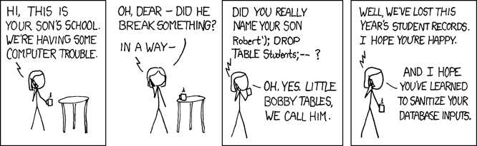
So what can go wrong?
When inputs are accepted from the internet, these can actually affect your table if you aren’t careful!

Slide 27
Can be more sophisticated
Use of AND, OR, and other quantifiers allows fairly complex concatenations of commands
  Not all of which you want to restrict away
  Many “restricted” keywords are perfectly acceptable English inputs!
Simple example:
  SELECT * FROM Users WHERE UserId = 105 or 1=1
  Why is this a bug?

Slide 28
Other attacks
In SQL, WHERE “”=“” is always true
Server code:
  uName = getRequestString("UserName");
  uPass = getRequestString("UserPass");
  sql = "SELECT * FROM Users WHERE Name ='" + uName + "' AND Pass ='" + uPass + "'”
Then simply insert “ or “”=“ into the box
Result:
  SELECT * FROM Users WHERE Name ="" or ""="" AND Pass ="" or ""="”
  Always true!

Slide 29
Real examples
In 2005, a company was put out of business because an SQL injection attack released over 200K credit cards (which were stored unencrypted…)
In 2007, the Microsoft UK page was defaced using an SQL injection
In 2008, Microsoft’s SQL server had an injection attack that took down thousands of PCs
Google SQL injection on any news site – these are all over.

Slide 30
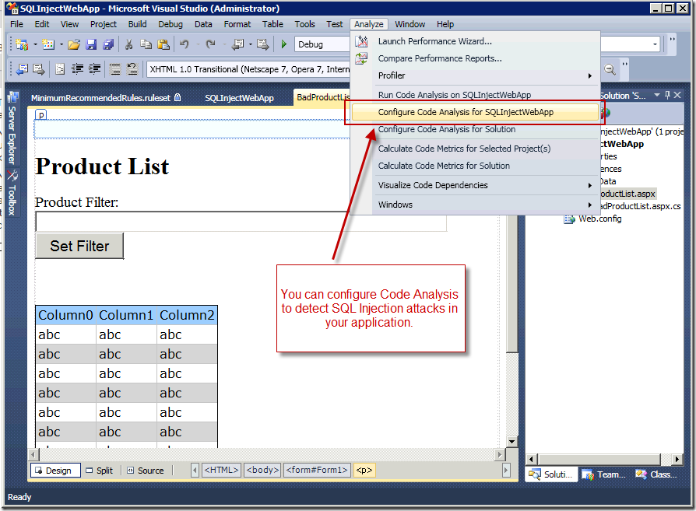
Ways to avoid these
Many vendor specific solutions to guard against these exist

Slide 31
Protection parameters
Best defense, however, is SQL parameters that are added to queries at execution time.
SQL engine will check each parameter to be sure it is correct for its column and are treated literally, and not as part of the statement to execute
Example:
txtUserId = getRequestString("UserId");
txtSQL = "SELECT * FROM Users WHERE UserId = @0";
db.Execute(txtSQL,txtUserId);

Slide 32
Another example
txtNam = getRequestString("CustomerName");
txtAdd = getRequestString("Address");
txtCit = getRequestString("City");
txtSQL = "INSERT INTO Customers (CustomerName,Address,City) Values(@0,@1,@2)";
db.Execute(txtSQL,txtNam,txtAdd,txtCit);
Note that these add work, but are worth it!
Variations in most languages.
  These are ASP .NET Razor examples.

