Slide 1
Notes:
Lecture slides prepared for “Computer Security: Principles and Practice”, 2/e, by William Stallings and Lawrie Brown, Chapter 13 “Trusted Computing and Multilevel Security”.

Slide 2

Chapter 13
Trusted Computing and Multilevel Security
Notes:
This chapter deals with a number of interrelated topics having to do with the degree
of confidence users and implementers can have in security functions and services:
• Formal models for computer security:
• Multilevel security
• Trusted systems
• Mandatory access control
• Security evaluation

Slide 3
Computer Security Models
problems involved both design and implementation
led to development of formal security models
  initially funded by US Department of Defense
Bell-LaPadula (BLP) model very influential
two fundamental computer security facts:
all complex software systems have eventually revealed flaws or bugs that need to be fixed
it is extraordinarily difficult to build computer hardware/software not vulnerable to security attacks
Notes:
Two historical facts highlight a fundamental problem that needs to be addressed in
the area of computer security. First, all complex software systems have eventually
revealed flaws or bugs that subsequently needed to be fixed. A good discussion of
this can be found in the classic The Mythical Man-Month [BROO95]. Second, it is
extraordinarily difficult, if not impossible, to build a computer hardware/ software
system that is not vulnerable to a variety of security attacks. An illustration of this
difficulty is the Windows NT operating system, introduced by Microsoft in the
early 1990s. Windows NT was promised to have a high degree of security and to be
far superior to previous OSs, including Microsoft’s Windows 3.0 and many other
personal computer, workstation, and server OSs. Sadly, Windows NT did not deliver
on this promise. This OS and its successor Windows versions have been chronically
plagued with a wide range of security vulnerabilities.
Problems to do with providing strong computer security involved both design
and implementation. It is difficult, in designing any hardware or software module,
to be assured that the design does in fact provide the level of security that was
intended. This difficulty results in many unanticipated security vulnerabilities. Even
if the design is in some sense correct, it is difficult, if not impossible, to implement
the design without errors or bugs, providing yet another host of vulnerabilities.
These problems have led to a desire to develop a method to prove, logically
or mathematically, that a particular design does satisfy a stated set of security
requirements and that the implementation of that design faithfully conforms to the
design specification. To this end, security researchers have attempted to develop
formal models of computer security that can be used to verify security designs and
implementations.
Initially, research in this area was funded by the U.S. Department of Defense
and considerable progress was made in developing models and in applying them
to prototype systems. That funding has greatly diminished as have attempts to
build formal models of complex systems. Nevertheless, such models have value in
providing a discipline and a uniformity in defining a design approach to security
requirements [BELL05]. In this section, we look at perhaps the most influential
computer security model, the Bell-LaPadula (BLP) model [BELL73, BELL75].
Several other models are examined in Section 13.2 .

Slide 4
Bell-LaPadula (BLP) Model
developed in 1970s
formal model for access control
subjects and objects are assigned a security class
  top secret > secret > confidential > restricted > unclassified
  form a hierarchy and are referred to as security levels
a subject has a security clearance
an object has a security classification
security classes control the manner by which a subject may access an object
Notes:
The BLP model was developed in the 1970s as a formal model for access
control. The model relied on the access control concept described in Chapter 4
(e.g., Figure 4.4 ). In the model, each subject and each object is assigned a security
class . In the simplest formulation, security classes form a strict hierarchy and
are referred to as security levels . One example is the U.S. military classification
scheme:
top secret > secret > confidential > restricted > unclassified
It is possible to also add a set of categories or compartments to each security
level, so that a subject must be assigned both the appropriate level and category to
access an object. We ignore this refinement in the following discussion.
This concept is equally applicable in other areas, where information can be
organized into gross levels and categories and users can be granted clearances to
access certain categories of data. For example, the highest level of security might be
for strategic corporate planning documents and data, accessible by only corporate
officers and their staff; next might come sensitive financial and personnel data,
accessible only by administration personnel, corporate officers, and so on. This
suggests a classification scheme such as
strategic > sensitive > confidential > public
A subject is said to have a security clearance of a given level; an object is said to
have a security classification of a given level. The security classes control the manner
by which a subject may access an object.

Slide 5
BLP Model Access Modes
READ
the subject is allowed only read access to the object
APPEND
the subject is allowed only write access to the object
WRITE
the subject is allowed both read and write access to the object
EXECUTE
the subject is allowed neither read nor write access to the object but may invoke the object for execution
multilevel security
  no read up
    subject can only read an object of less or equal security level
    referred to as the simple security property (ss-property)
  no write down
    a subject can only write into an object of greater or equal security level
    referred to as the *-property
Notes:
The model defined four access modes,
although the authors pointed out that in specific implementation environments, a
different set of modes might be used. The modes are as follows:
• read: The subject is allowed only read access to the object.
• append: The subject is allowed only write access to the object.
• write: The subject is allowed both read and write access to the object.
• execute: The subject is allowed neither read nor write access to the object but
may invoke the object for execution.
When multiple categories or levels of data are defined, the requirement is
referred to as multilevel security . The general statement of the requirement for
confidentiality-centered multilevel security is that a subject at a high level may not
convey information to a subject at a lower level unless that flow accurately reflects
the will of an authorized user as revealed by an authorized declassification. For
implementation purposes, this requirement is in two parts and is simply stated.
A multilevel secure system for confidentiality must enforce the following:
• No read up: A subject can only read an object of less or equal security level.
This is referred to in the literature as the simple security property (ss-property) .
• No write down: A subject can only write into an object of greater or equal
security level. This is referred to in the literature as the *-property (pronounced
star property ).

Slide 6
Multi-Level Security
Notes:
Figure 13.1 illustrates the need for the *-property. Here, a malicious subject
passes classified information along by putting it into an information container
labeled at a lower security classification than the information itself. This will allow a
subsequent read access to this information by a subject at the lower clearance level.
These two properties provide the confidentiality form of what is known as
mandatory access control (MAC). Under this MAC, no access is allowed that does
not satisfy these two properties. In addition, the BLP model makes a provision for
discretionary access control (DAC).
• ds-property : An individual (or role) may grant to another individual (or role)
access to a document based on the owner’s discretion, constrained by the MAC
rules. Thus, a subject can exercise only accesses for which it has the necessary
authorization and which satisfy the MAC rules.
The basic idea is that site policy overrides any discretionary access controls.
That is, a user cannot give away data to unauthorized persons.

Slide 7
BLP Formal Description
based on current state of system (b, M, f, H):
  (current access set b, access matrix M, level function f, hierarchy H)
three BLP properties:
  ss-property: (S_{i}, O_{j}, read) has f_{c}(S_{i}) ≥ f_{o}(O_{j})
  *-property: (S_{i}, O_{j}, append) has f_{c}(S_{i}) ≤ f_{o}(O_{j}) and
    (S_{i}, O_{j}, write) has f_{c}(S_{i}) = f_{o}(O_{j})
  ds-property: (S_{i}, O_{j}, A_{x}) implies A_{x} ∈ M[S_{i} O_{j}]
BLP gives formal theorems
  theoretically possible to prove system is secure
  in practice usually not possible
Notes:
We use the notation presented in [BELL75]. The model is based on the concept of a
current state of the system. The state is described by the 4-tuple ( b , M , f , H ), defined
as follows:
• Current access set b : This is a set of triples of the form (subject, object, access-
mode). A triple ( s , o , a ) means that subject s has current access to o in access
mode a . Note that this does not simply mean that s has the access right a to o . The
triple means that s is currently exercising that access right; that is s is currently
accessing o by mode a .
Access matrix M : The access matrix has the structure indicated in Chapter 4 .
The matrix element M _{ij} records the access modes in which subject S _{i} is permitted
to access object O _{j} .
• Level function f : This function assigns a security level to each subject and
object. It consists of three mappings: f _{o} ( O _{j} ) is the classification level of object
O _{j} ; f _{s} ( S _{i} ) is the security clearance of subject S _{i} ; f _{c} ( S _{i} ) is the current security
level of subject S _{i} . The security clearance of a subject is the maximum security
level of the subject. The subject may operate at this level or at a lower level.
Thus, a user may log onto the system at a level lower than the user’s security
clearance. This is particularly useful in a role-based access control system.
• Hierarchy H : This is a directed rooted tree whose nodes correspond to objects
in the system. The model requires that the security level of an object must
dominate the security level of its parent. For our discussion, we may equate
this with the condition that the security level of an object must be greater than
or equal to its parent.
We can now define the three BLP properties more formally. For every subject
S _{i} and every object O _{j} , the requirements can be stated as follows:
• ss-property: Every triple of the form ( S _{i} , O _{j} , read) in the current access set b
has the property f_{c}(S_{i}) ≥ f_{o}(O_{j}) .
• *-property: Every triple of the form ( S _{i} , O _{j} , append) in the current access set b
has the property f_{c}(S_{i}) ≤ f_{o}(O_{j}) . Every triple of the form ( S _{i} , O _{j} , write) in the
current access set b has the property f _{c} ( S _{i} ) f _{o} ( O _{j} ).
• ds-property: If ( S _{i} , O _{j} , A _{x} ) is a current access (is in b ), then access mode A _{x}
is recorded in the ( S _{i} , O _{j} ) element of M . That is, ( S _{i} , O _{j} , A _{x} ) implies that
A_{x} ∈ M[S_{i},O_{j}] .
These three properties can be used to define a confidentiality secure system.
In essence, a secure system is characterized by the following:
1. The current security state of the system ( b , M , f , H ) is secure if and only if
every element of b satisfies the three properties.
2. The security state of the system is changed by any operation that causes a
change any of the four components of the system, ( b , M , f , H ).
3. A secure system remains secure so long as any state change does not violate
the three properties.
[BELL75] shows how these three points can be expressed as theorems using the
formal model. Further, given an actual design or implementation, it is theoretically
possible to prove the system secure by proving that any action that affects the state
of the system satisfies the three properties. In practice, for a complex system, such
a proof has never been fully developed. However, as mentioned earlier, the formal
statement of requirements can lead to a more secure design and implementation.

Slide 8
BLP Rules
1
release access
change object level
change current level
give access permission
create an object
delete a group of objects
get access
2
3
4
5
6
7
Notes:
The BLP model includes a set of rules based on abstract operations that change the
state of the system. The rules are as follows:
1. Get access: Add a triple ( subject , object , access-mode ) to the current access set b .
Used by a subject to initiate access to an object in the requested mode.
2. Release access: Remove a triple ( subject , object , access-mode ) from the current
access set b . Used to release previously initiated access.
3. Change object level: Change the value of f _{o} ( O _{j} ) for some object O _{j} . Used by a
subject to alter the security level of an object.
4. Change current level: Change the value of f _{c} ( S _{i} ) for some subject S _{i} . Used by a
subject to alter the security level of a subject.
5. Give access permission: Add an access mode to some entry of the access
permission matrix M . Used by a subject to grant an access mode on a specified
object to another subject.
6. Rescind access permission: Delete an access mode from some entry of M .
Used by a subject to revoke an access previously granted.
7. Create an object: Attach an object to the current tree structure H as a leaf.
Used to create a new object or activate an object that has previously been
defined but is inactive because it has not been inserted into H .
8. Delete a group of objects: Detach from H an object and all other objects
beneath it in the hierarchy. This renders the group of objects inactive. This
operation may also modify the current access set b because all accesses to the
object are released.
Rules 1 and 2 alter the current access; rules 3 and 4 alter the level functions;
rules 5 and 6 alter access permission; and rules 7 and 8 alter the hierarchy. Each rule
is governed by the application of the three properties. For example, for get access
for a read, we must have f_{c}(S_{i}) ≥ f_{o}(O_{j}) and A, ε M[S_{i},O_{j}] .

Slide 9
BLP Example
(slide 1 of 3)
Notes:
An example, from [WEIP06] illustrates the operation of the BLP model and also
highlights a practical issue that must be addressed. We assume a role-based access
control system. Carla and Dirk are users of the system. Carla is a student (s) in
course c1. Dirk is a teacher (t) in course c1 but may also access the system as a
student; thus two roles are assigned to Dirk:
Carla: (c1-s)
Dirk: (c1-t), (c1-s)
The student role is assigned a lower security clearance and the teacher role a
higher security clearance. Let us look at some possible actions:
1. Dirk creates a new file f1 as c1-t; Carla creates file f2 as c1-s ( Figure 13.2a ).
Carla can read and write to f2, but cannot read f1, because it is at a higher
classification level (teacher level). In the c1-t role, Dirk can read and write f1
and can read f2 if Carla grants access to f2. However, in this role, Dirk cannot
write f2 because of the *-property; neither Dirk nor a Trojan horse on his
behalf can downgrade data from the teacher level to the student level. Only if
Dirk logs in as a student can he create a c1-s file or write to an existing c1-s file,
such as f2. In the student role, Dirk can also read f2.
2. Dirk reads f2 and wants to create a new file with comments to Carla as feedback.
Dirk must sign in student role c1-s to create f3 so that it can be accessed
by Carla ( Figure 13.2b ). In a teacher role, Dirk cannot create a file at a student
classification level.

Slide 10
BLP Example
(slide 2 of 3)
Notes:
Dirk creates an exam based on an existing template file store at level c1-t.
Dirk must log in as c1-t to read the template and the file he creates (f4) must
also be at the teacher level ( Figure 13.2c ).
4. Dirk wants Carla to take the exam and so must provide her with read access.
However, such access would violate the ss-property. Dirk must downgrade
the classification of f4 from c1-t to c1-s. Dirk cannot do this in the c1-t role
because this would violate the *-property. Therefore, a security administrator
(possibly Dirk in this role) must have downgrade authority and must be able to perform the
downgrade outside the BLP model. The dotted line in
Figure 13.2d connecting f4 with c1-s-read indicates that this connection has
not been generated by the default BLP rules but by a system operation.

Slide 11
BLP Example
(slide 3 of 3)
Notes:
5. Carla writes the answers to the exam into a file f5. She creates the file at
level c1-t so that only Dirk can read the file. This is an example of writing up,
which is not forbidden by the BLP rules. Carla can still see her answers at her
workstation but cannot access f5 for reading.
This discussion illustrates some critical practical limitations of the BLP
model. First, as noted in step 4, the BLP model has no provision to manage the
“downgrade” of objects, even though the requirements for multilevel security
recognize that such a flow of information from a higher to a lower level may be
required, provided it reflects the will of an authorized user. Hence, any practical
implementation of a multilevel system has to support such a process in a controlled
and monitored manner. Related to this is another concern. A subject constrained
by the BLP model can only be “editing” (reading and writing) a file at one security
level while also viewing files at the same or lower levels. If the new document
consolidates information from a range of sources and levels, some of that information
is now classified at a higher level than it was originally. This is known as classification
creep and is a well-known concern when managing multilevel information.
Again, some process of managed downgrading of information is needed to restore
reasonable classification levels.

Slide 12
Implementation Example
Multics
Notes:
[BELL75] outlines an implementation of MLS on the Multics operating system. We
begin with a brief description of the relevant aspects of Multics.
Multics is a time-sharing operating system that was developed by a group
at MIT known as Project MAC (multiple-access computers) in the 1960s. Multics
was not just years but decades ahead of its time. Even by the mid-1980s, almost
20 years after it became operational, Multics had superior security features and
greater sophistication in the user interface and other areas than other contemporary
mainframe operating systems.
Both memory management and the file system in Multics are based on the
concept of segments. Virtual memory is segmented. For most hardware platforms,
paging is also used. In any case, the working space of a process is assigned to a segment
and a process may create one or more data segments for use during execution. Each
file in the file system is defined as a segment. Thus, the OS uses the same mechanism
to load a data segment from virtual memory into main memory and to load a file
from virtual memory into main memory. Segments are arranged hierarchically, from
a root directory down to individual segments.
Multics manages the virtual address space by means of a descriptor segment,
which is associated with a process and which has one entry for each segment in virtual
memory accessible by this process. The descriptor segment base register points to
the start of the descriptor segment for the process that is currently executing. The
descriptor entry includes a pointer to the start of the segment in virtual memory
plus protection information, in the form of read, write, and execute bits, which may
be individually set to ON or OFF. The protection information found in a segment’s
descriptor is derived from the access control list for the segment.
For MLS, two additional features are required. A process-level table includes
an entry of each active process, and the entry indicates the security clearance of
the process. Associated with each segment is a security level, which is stored in the
parent directory segment of the segment in question.
Corresponding to the security state of the BLP model ( b , M , f , H ) is a set of
Multics data structures ( Figure 13.3 ). The correspondence is as follows:
b: Segment descriptor word. The descriptor segment identifies the subject
(process). The segment pointer in segment descriptor word identifies
the object (data segment). The three access control bits in the segment
descriptor word identify the access mode.
M: Access control list.
f: Information in the directory segment and in the process-level table.
H: Hierarchical segment structure.
With these data structures, Multics can enforce discretionary and mandatory
access control. When a process attempts an access to a segment, it must
have the desired access permission as specified by the access control list. Also,
its security clearance is compared to the security classification of the segment to
be accessed to determine if the simple security rule and *-property security rule
are satisfied.

Slide 13
Biba Integrity Model
BLP is concerned with unauthorized disclosure of information.
In contrast, the Biba integrity model is almost the reverse – it is designed to guard against the unauthorizied modification of data.
Notes:
The BLP model deals with confidentiality and is concerned with unauthorized
disclosure of information. The Biba [BIBA77] models deals with integrity and is concerned
with the unauthorized modification of data. The Biba model is intended to
deal with the case in which there is data that must be visible to users at multiple or all
security levels but should only be modified in controlled ways by authorized agents.
The basic elements of the Biba model have the same structure as the BLP
model. As with BLP, the Biba model deals with subjects and objects. Each subject
and object is assigned an integrity level, denoted as I( S ) and I( O ) for subject S and
object O , respectively. A simple hierarchical classification can be used, in which there
is a strict ordering of levels from lowest to highest. As in the BLP model, it is also
possible to add a set of categories to the classification scheme; this we ignore here.
The model considers the following access modes:
• Modify: To write or update information in an object
• Observe: To read information in an object
• Execute: To execute an object
• Invoke: Communication from one subject to another
The first three modes are analogous to BLP access modes. The invoke mode is
new. Biba then proposes a number of alternative policies that can be imposed on this
model. The most relevant is the strict integrity policy, based on the following rules:
• Simple integrity: A subject can modify an object only if the integrity level of
the subject dominates the integrity level of the object: I( S ) ≥ I( O ).
• Integrity confinement: A subject can read an object only if the integrity level
of the subject is dominated by the integrity level of the object: I( S ) ≤ I( O ).
• Invocation property: A subject can invoke another subject only if the integrity
level of the first subject dominates the integrity level of the second subject:
I( S ₁ ) ≥ I( S ₂ ).
The first two rules are analogous to those of the BLP model but are concerned
with integrity and reverse the significance of read and write. The simple integrity rule
is the logical write-up restriction that prevents contamination of high-integrity data.
Figure 13.4 illustrates the need for the integrity confinement rule. A low-integrity
process may read low-integrity data but is prevented from contaminating a high integrity
file with that data by the simple integrity rule. If only this rule is in force, a
high-integrity process could conceivably copy low-integrity data into a high-integrity
file. Normally, one would trust a high-integrity process to not contaminate a high integrity
file, but either an error in the process code or a Trojan horse could result in
such contamination; hence the need for the integrity confinement rule.

Slide 14
Biba Integrity Model
strict integrity policy:
  simple integrity: Can only write down, so can’t contaminate high-level data
    I(S) ≥ I(O)
  integrity confinement: Can only read up (so high level but compromised subjects cannot copy low integrity data up)
    I(S) ≤ I(O)
  invocation property: essentially, only want to allow communication to go “down”
    I(S₁) ≥ I(S₂)
Notes:
The BLP model deals with confidentiality and is concerned with unauthorized
disclosure of information. The Biba [BIBA77] models deals with integrity and is concerned
with the unauthorized modification of data. The Biba model is intended to
deal with the case in which there is data that must be visible to users at multiple or all
security levels but should only be modified in controlled ways by authorized agents.
The basic elements of the Biba model have the same structure as the BLP
model. As with BLP, the Biba model deals with subjects and objects. Each subject
and object is assigned an integrity level, denoted as I( S ) and I( O ) for subject S and
object O , respectively. A simple hierarchical classification can be used, in which there
is a strict ordering of levels from lowest to highest. As in the BLP model, it is also
possible to add a set of categories to the classification scheme; this we ignore here.
The model considers the following access modes:
• Modify: To write or update information in an object
• Observe: To read information in an object
• Execute: To execute an object
• Invoke: Communication from one subject to another
The first three modes are analogous to BLP access modes. The invoke mode is
new. Biba then proposes a number of alternative policies that can be imposed on this
model. The most relevant is the strict integrity policy, based on the following rules:
• Simple integrity: A subject can modify an object only if the integrity level of
the subject dominates the integrity level of the object: I( S ) ≥ I( O ).
• Integrity confinement: A subject can read an object only if the integrity level
of the subject is dominated by the integrity level of the object: I( S ) ≤ I( O ).
• Invocation property: A subject can invoke another subject only if the integrity
level of the first subject dominates the integrity level of the second subject:
I( S ₁ ) ≥ I( S ₂ ).
The first two rules are analogous to those of the BLP model but are concerned
with integrity and reverse the significance of read and write. The simple integrity rule
is the logical write-up restriction that prevents contamination of high-integrity data.
Figure 13.4 illustrates the need for the integrity confinement rule. A low-integrity
process may read low-integrity data but is prevented from contaminating a high integrity
file with that data by the simple integrity rule. If only this rule is in force, a
high-integrity process could conceivably copy low-integrity data into a high-integrity
file. Normally, one would trust a high-integrity process to not contaminate a high integrity
file, but either an error in the process code or a Trojan horse could result in
such contamination; hence the need for the integrity confinement rule.

Slide 15
Clark-Wilson Integrity Model
Aimed at commercial and not military applications
Two main concepts:
  Well formed transactions: no arbitrary manipulation of data
  Separation of duty among users: If you can create a well formed transaction, you cannot execute it.
Highly generic and adaptable: the notion of a well formed transaction will vary based on setting, but always have certification and enforcement rules set up.
Notes:
A more elaborate and perhaps more practical integrity model was proposed by Clark
and Wilson [CLAR87]. The Clark-Wilson model (CWM) is aimed at commercial
rather than military applications and closely models real commercial operations. The
model is based on two concepts that are traditionally used to enforce commercial
security policies:
• Well-formed transactions: A user should not manipulate data arbitrarily, but
only in constrained ways that preserve or ensure the integrity of the data.
• Separation of duty among users: Any person permitted to create or certify a
well-formed transaction may not be permitted to execute it (at least against
production data).
The model imposes integrity controls on data and the transactions that
manipulate the data. The principal components of the model are as follows:

Slide 16
Clark-Wilson Integrity Model
Notes:
• Constrained data items (CDIs): Subject to strict integrity controls.
• Unconstrained data items (UDIs): Unchecked data items. An example is a
simple text file.
• Integrity verification procedures (IVPs): Intended to assure that all CDIs
conform to some application-specific model of integrity and consistency.
• Transformation procedures (TPs): System transactions that change the set of
CDIs from one consistent state to another.
The CWM enforces integrity by means of certification and enforcement rules
on TPs. Certification rules are security policy restrictions on the behavior of IVPs
and TPs. Enforcement rules are built-in system security mechanisms that achieve
the objectives of the certification rules. The rules are as follows:
Cl: All IVPs must properly ensure that all CDIs are in a valid state at the time
the IVP is run.
C2: All TPs must be certified to be valid. That is, they must take a CDI to a valid
final state, given that it is in a valid state to begin with. For each TP, and
each set of CDIs that it may manipulate, the security officer must specify a
relation, which defines that execution. A relation is thus of the form (TPi,
(CDIa, CDIb, CDIc . . . )), where the list of CDIs defines a particular set of
arguments for which the TP has been certified.
El: The system must maintain the list of relations specified in rule C2 and
must ensure that the only manipulation of any CDI is by a TP, where the
TP is operating on the CDI as specified in some relation.
E2: The system must maintain a list of relations of the form (UserID, TPi,
(CDIa, CDIb, CDIc, . . . )), which relates a user, a TP, and the data objects
that TP may reference on behalf of that user. It must ensure that only
executions described in one of the relations are performed.
C3: The list of relations in E2 must be certified to meet the separation of duty
requirement.
E3: The system must authenticate the identity of each user attempting to
execute a TP.
C4: All TPs must be certified to write to an append-only CDI (the log) all information
necessary to permit the nature of the operation to be reconstructed.
C5: Any TP that takes a UDI as an input value must be certified to perform
only valid transformations, or else no transformations, for any possible
value of the UDI. The transformation should take the input from a UDI
to a CDI, or the UDI is rejected. Typically, this is an edit program.
E4: Only the agent permitted to certify entities may change the list of such
entities associated with other entities: specifically, the list of TPs associated
with a CDI and the list of users associated with a TP. An agent that can
certify an entity may not have any execute rights with respect to that entity.
Figure 13.5 illustrates the rules. The rules combine to form a two-part integrity
assurance facility, in which certification is done by a security officer with respect to
an integrity policy, and enforcement is done by the system.

Slide 17
Chinese Wall Model
Designed for commercial applications where there are conflicts of interest.
Example: Financial advisors cannot provide unbiased advice to a company if they have confidential knowledge of another.
No real security levels here, however; access history determines access control.

Slide 18
Chinese
Wall
Model
Notes:
To enforce the Chinese wall policy, two rules are needed. To indicate the similarity
with the two BLP rules, the authors gave them the same names. The first rule
is the simple security rule:
Simple security rule: A subject S can read on object O only if
• O is in the same DS as an object already accessed by S, OR
• O belongs to a CI from which S has not yet accessed any information
Figures 13.6b and c illustrate the operation of this rule. Assume that at some
point, John has made his first read request to any object in this set for an object in
the Bank A DS. Because John has not previously accessed an object in any other
DS in CI 1, the access is granted. Further, the system must remember that access
has been granted so that any subsequent request for access to an object in the Bank
B DS will be denied. Any request for access to other objects in the Bank A DS is
granted. At a later time, John requests access to an object in the Oil A DS. Because
there is no conflict, this access is granted, but a wall is set up prohibiting subsequent
access to the Oil B DS. Similarly, Figure 13.6c reflects the access history of Jane.
The simple security rule does not prevent an indirect flow of information that
would cause a conflict of interest. In our example, John has access to Oil A DS and
Bank A DS; Jane has access to Oil B DS and Bank A DS. If John is allowed to read
from the Oil A DS and write into the Bank A DS, John may transfer information
about Oil A into the Bank A DS; this is indicated by changing the value of the first
object under the Bank A DS to g . The data can then subsequently be read by Jane.
Thus, Jane would have access to information about both Oil A and Oil B, creating
a conflict of interest. To prevent this, the CWM has a second rule:
*-property rule: A subject S can write an object O only if
• S can read O according to the simple security rule, AND
• All objects that S can read are in the same DS as O.
Put another way, either subject cannot write at all, or a subject’s access (both
read and write) is limited to a single dataset. Thus, in Figure 13.6 , neither John nor
Jane has write access to any objects in the overall universe of data.
The *-property rule is quite restrictive. However, in many cases, a user only
needs read access because the user is performing some analysis role.
To somewhat ease the write restriction, the model includes the concept
of sanitized data . In essence, sanitized data are data that may be derived from
corporate data but that cannot be used to discover the corporation’s identity. Any
DS consisting solely of sanitized data need not be protected by a wall; thus the two
CWM rules do not apply to such DSs.

Slide 19
Chinese Wall Model
Simple security rule: A subject can read an object if it is in the same data set as an object already accessed, or if the object belongs to a conflict of interest class which has not yet been accessed.
*-property: A subject can write to an object only if it can read it according to the ss-rule (above), and all objects the subject can read are in the SAME data set.
  This prevents writing secure data in another data set.
  Generally exceptions are made if data is sanitized.

Slide 20
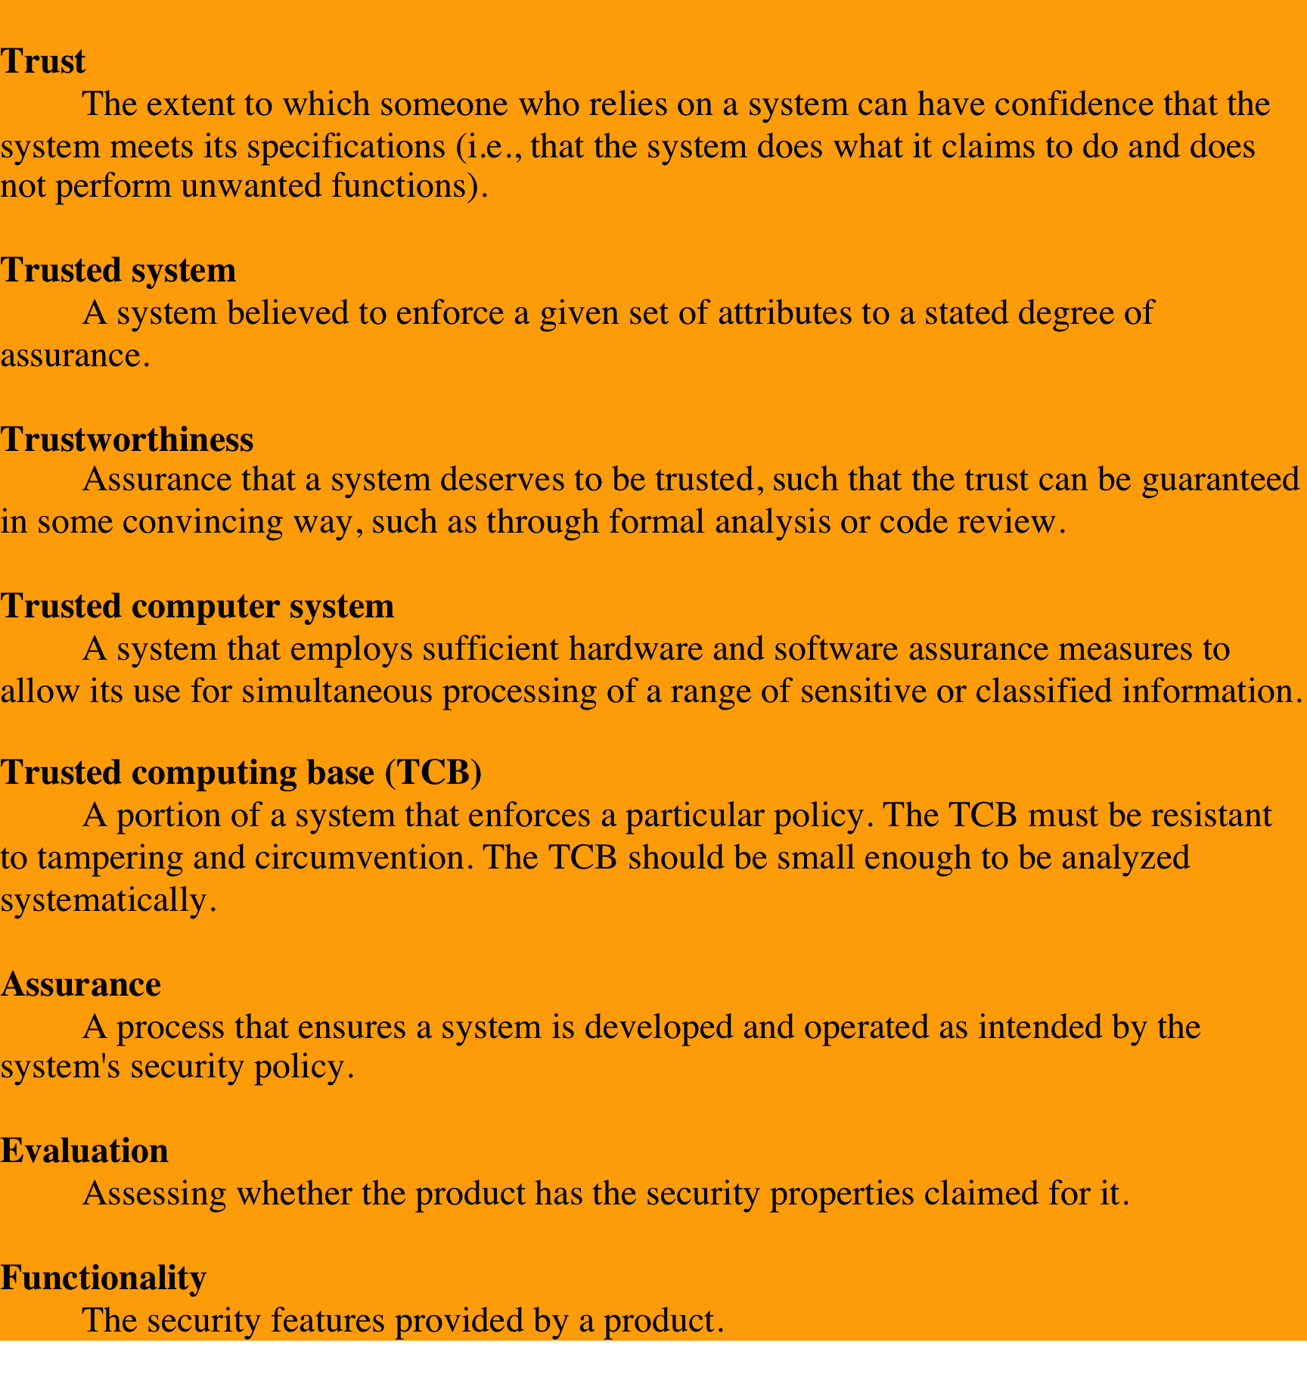
Table 13.1
Terminology
Related to
Trust
Notes:
The models described in the preceding two sections are all aimed at enhancing
the trust that users and administrators have in the security of a computer
system. The concept of trust in the context of computer security goes back to
the early 1970s, spurred on by the U.S. Department of Defense initiative and
funding in this area. Early efforts were aimed to developing security models
and then designing and implementing hardware/software platforms to achieve
trust. Because of cost and performance issues, trusted systems did not gain a
serious foothold in the commercial market. More recently, the interest in trust
has reemerged, with the work on trusted computer platforms, a topic we explore
in Section 13.5 . In this section, we examine some basic concepts and implications
of trusted systems.
Some useful terminology related to trusted systems is listed in Table 13.1 .

Slide 21
Reference Monitors
Notes:
Initial work on trusted computers and trusted operating systems was based on
the reference monitor concept, depicted in Figure 13.7 . The reference monitor is
a controlling element in the hardware and operating system of a computer that
regulates the access of subjects to objects on the basis of security parameters of
the subject and object. The reference monitor has access to a file, known as the
security kernel database , that lists the access privileges (security clearance) of
each subject and the protection attributes (classification level) of each object. The
reference monitor enforces the security rules (no read up, no write down) and has
the following properties:
• Complete mediation: The security rules are enforced on every access, not just,
for example, when a file is opened.
• Isolation: The reference monitor and database are protected from unauthorized
modification.
• Verifiability: The reference monitor’s correctness must be provable. That
is, it must be possible to demonstrate mathematically that the reference
monitor enforces the security rules and provides complete mediation and
isolation.
These are stiff requirements. The requirement for complete mediation means
that every access to data within main memory and on disk and tape must be mediated.
Pure software implementations impose too high a performance penalty to be practical;
the solution must be at least partly in hardware. The requirement for isolation means
that it must not be possible for an attacker, no matter how clever, to change the logic
of the reference monitor or the contents of the security kernel database. Finally, the
requirement for mathematical proof is formidable for something as complex as a
general-purpose computer. A system that can provide such verification is referred to
as a trustworthy system .
A final element illustrated in Figure 13.7 is an audit file. Important security
events, such as detected security violations and authorized changes to the security
kernel database, are stored in the audit file.
In an effort to meet its own needs and as a service to the public, the U.S.
Department of Defense in 1981 established the Computer Security Center within
the National Security Agency (NSA) with the goal of encouraging the widespread
availability of trusted computer systems. This goal is realized through the center’s
Commercial Product Evaluation Program. In essence, the center attempts to
evaluate commercially available products as meeting the security requirements
just outlined. The center classifies evaluated products according to the range of
security features that they provide. These evaluations are needed for Department
of Defense procurements but are published and freely available. Hence, they
can serve as guidance to commercial customers for the purchase of commercially
available, off-the-shelf equipment.

Slide 22
Trojan Horse Defense
Notes:
One way to secure against Trojan horse attacks is the use of a secure, trusted
operating system. Figure 13.8 illustrates an example. In this case, a Trojan horse
is used to get around the standard security mechanism used by most file management
and operating systems: the access control list. In this example, a user named
Bob interacts through a program with a data file containing the critically sensitive
character string “CPE170KS.” User Bob has created the file with read/write
permission provided only to programs executing on his own behalf: that is, only
processes that are owned by Bob may access the file.
The Trojan horse attack begins when a hostile user, named Alice, gains
legitimate access to the system and installs both a Trojan horse program and a private
file to be used in the attack as a “back pocket.” Alice gives read/write permission
to herself for this file and gives Bob write-only permission ( Figure 13.8a ). Alice
now induces Bob to invoke the Trojan horse program, perhaps by advertising it
as a useful utility. When the program detects that it is being executed by Bob, it
reads the sensitive character string from Bob’s file and copies it into Alice’s back pocket
file ( Figure 13.8b ). Both the read and write operations satisfy the constraints
imposed by access control lists. Alice then has only to access Bob’s file at a later
time to learn the value of the string.
Now consider the use of a secure operating system in this scenario ( Figure 13.8c ).
Security levels are assigned to subjects at logon on the basis of criteria such as the
terminal from which the computer is being accessed and the user involved, as identified
by password/ID. In this example, there are two security levels, sensitive and public,
ordered so that sensitive is higher than public. Processes owned by Bob and Bob’s data
file are assigned the security level sensitive. Alice’s file and processes are restricted to
public. If Bob invokes the Trojan horse program ( Figure 13.8d ), that program acquires
Bob’s security level. It is therefore able, under the simple security property, to observe
the sensitive character string. When the program attempts to store the string in a
public file (the back-pocket file), however, the *-property is violated and the attempt
is disallowed by the reference monitor. Thus, the attempt to write into the back-pocket
file is denied even though the access control list permits it: The security policy takes
precedence over the access control list mechanism.

Slide 23
Multilevel Security (MLS)
RFC 2828 defines multilevel security as follows:
“A class of system that has system resources
(particularly stored information) at more than one security level (i.e., has different types of sensitive resources) and that permits concurrent access by users who differ in security clearance and need-to-know, but is able to prevent each user from accessing resources for which the user lacks authorization.”
Notes:
Multilevel security is of interest when there is a requirement to maintain
a resource, such as a file system or database in which multiple levels of data
sensitivity are defined. The hierarchy could be as simple as two levels (e.g., public
and proprietary) or could have many levels (e.g., the military unclassified,
restricted, confidential, secret, top secret). The preceding three sections have
introduced us to the essential elements of multilevel security. In this section, we
look at two applications areas where MLS concepts have been applied: role-based
access control system and database security.

Slide 24
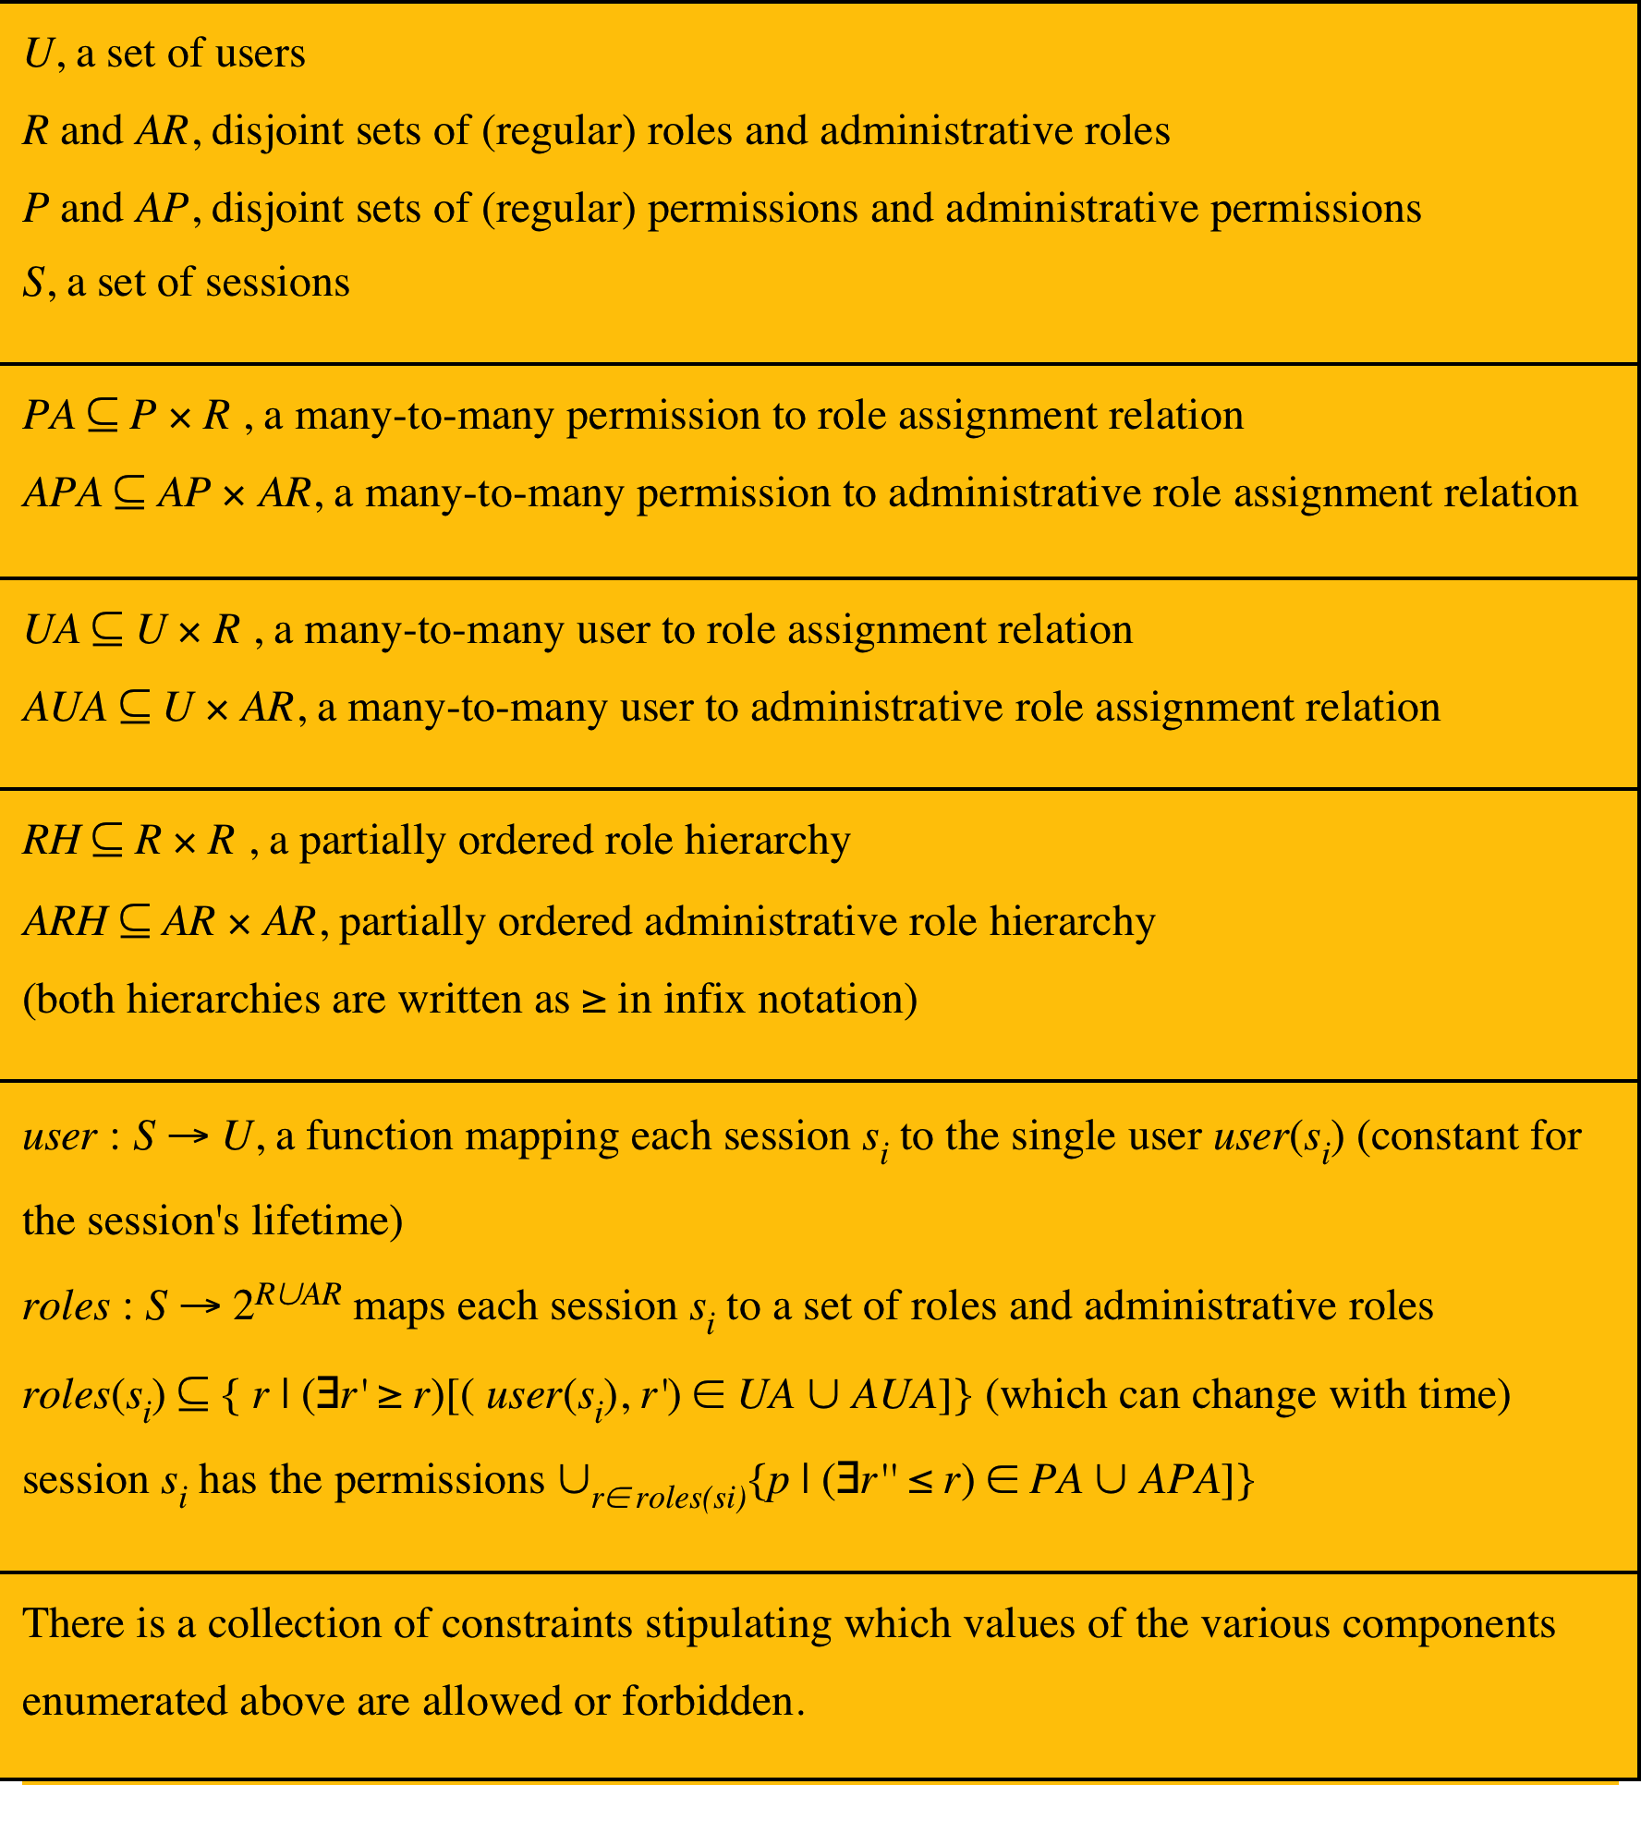
Table 13.2 using RBAC
(to implement BLP)
Notes:
[OSBO00] shows how a rule-based access control (RBAC) system can be used to
implement the BLP multilevel security rules. Recall that the ANSI standard RBAC
specification included the concept of administrative functions, which provide
the capability to create, delete, and maintain RBAC elements and relations. It is
useful here to assign special administrative roles to these functions. With this in
mind, Table 13.2 summarizes the components of an RBAC.
The following formal specification indicates how a RBAC system can be used
to implement MLS access:
• Constraint on Users: For each user u in the set of users U, a security clearance L(u) is assigned. Formally, ∀u ∈ U [L(u) is given]
• Constraints on Permissions: Each permission assigns a read or write permission to an object o, and each object has one read and one write permission. All objects have a security classification. Formally: P = {(o, r), (o,w) | o is an object in the system}; ∀o ∈ P [L(o) is given]
• Definitions: The read-level of a role r, denoted r-level(r), is the least upper bound of the security levels of the objects for which (o, r) is in the permissions of r. The w-level of a role r (denoted w-level(r)) is the greatest lower bound of the security levels of the objects o for which (o, w) is in the permissions of r, if such a glb exists. If the glb does not exist, the w-level is undefined.
• Constraint on UA (user-role assignments): Each role r has a defined write-level w-level(r). For each user assignment, the clearance of the user must dominate the r-level of the role and be dominated by the w-level of the role. Formally: ∀r ∈ UA [w-level(r) is defined]; ∀(u, r) ∈ UA [L(u) ≥ r-level(r)]; ∀(u, r) ∈ UA [L(u) ≤ w-level(r)].
The preceding definitions and constraints enforce the BLP model. A role can
include access permissions for multiple objects. The r-level of the role indicates the
highest security classification for the objects assigned to the role. Thus, the simple
security property (no read up) demands that a user can be assigned to a role only if
the user’s clearance is at least as high as the r-level of the role. Similarly, the w-level
of the role indicates the lowest security classification of its objects. The *-security
property (no write down) demands that a user be assigned to a role only if the user’s
clearance is no higher than the w-level of the role.

Slide 25
Figure
13.9
Role
Hierarchy
User
Assignments
Notes:
Figure 13.9 is an example of a possible role hierarchy for a system with unclassified,
secret, and top secret security classifications. Roles are indicated by type
of access and classification level of objects. For example, the role (ru, rs) includes
read access to some unclassified and some secret objects. Each role may have permissions
inherited because of the role hierarchy. Role ru1 has read access to some
unclassified objects; role ru2 inherits these permissions and has additional read
access to objects at the unclassified level. The (ru, ws) role contains permissions
to read some unclassified objects and write some secret objects. This role could be
assigned in UA to either unclassified or secret users. The role at the upper right
cannot be assigned to any user without violating either the simple security property
or the *-property.

Slide 26
Database Classification
Table
Column
Notes:
The addition of multilevel security to a database system increases the complexity of
the access control function and of the design of the database itself. One key issue
is the granularity of classification. The following are possible methods of imposing
multilevel security on a relational database, in terms of the granularity of classification
( Figure 13.10 ):
• Entire database: This simple approach is easily accomplished on an MLS
platform. An entire database, such as a financial or personnel database,
could be classified as confidential or restricted and maintained on a server
with other files.
• Individual tables (relations): For some applications, it is appropriate to assign
classification at the table level. In the example of Figure 13.10a , two levels of
classification are defined: unrestricted (U) and restricted (R). The Employee
table contains sensitive salary information and is classified restricted, while
the Department table is unrestricted. This level of granularity is relatively easy
to implement and enforce.
• Individual columns (attributes): A security administrator may choose to
determine classification on the basis of attributes, so that selected columns
are classified. In the example of Figure 13.10b , the administrator determines
that salary information and the identity of department managers is restricted
information.

Slide 27
Database Classification
Row
Element
Notes:
Individual rows (tuples): In other circumstances, it may make sense to assign
classification levels on the basis of individual rows that match certain properties.
In the example of Figure 13.10c , all rows in the Department table that contain
information relating to the Accounts Department (Dept. ID 4), and all rows
in the Employee table for which the Salary is greater than 50K are restricted.
• Individual elements: The most difficult scheme to implement and manage is
one in which individual elements may be selectively classified. In the example
of Figure 13.10d , salary information and the identity of the manager of the
Accounts Department are restricted.
The granularity of the classification scheme affects the way in which access
control is enforced. In particular, efforts to prevent inference depend on the
granularity of the classification.

Slide 28

Database Security
Read Access
DBMS enforces simple security rule (no read up)
easy if granularity is entire database or at table level
inference problems if have column granularity
  if can query on restricted data can infer its existence
    SELECT Ename FROM Employee WHERE Salary > 50K
  solution is to check access to all query data
also have problems if have row granularity
  null response indicates restricted/empty result
no extra concerns if have element granularity
Notes:
For read access, a database system needs to enforce the simple
security rule (no read up). This is straightforward if the classification granularity
is the entire database or at the table level. Consider now a database classified by
column (attribute). For example, in Figure13.10b, suppose that a user with only
unrestricted clearance issues the following SQL query:
SELECT Ename
FROM Employee
WHERE Salary > 50K
This query returns only unrestricted data but reveals restricted information, namely
whether any employees have a salary greater than 50K and, if so, which employees.
This type of security violation can be addressed by considering not only the data
returned to the user but also any data that must be accessed to satisfy the query.
In this case, the query requires access to the Salary attribute, which is unauthorized
for this user; therefore, the query is rejected.
If classification is by row (tuple) rather than column, then the preceding query
does not pose an inference problem. Figure 13.10c shows that in the Employee table,
all rows corresponding to salaries greater than 50K are restricted. Because all such
records will be removed from the response to the preceding query, the inference
just discussed cannot occur. However, some information may be inferred, because a
null response indicates either that salaries above 50 are restricted, or no employee
has a salary greater than 50K.
The use of classification by rows instead of columns creates other inference
problems. For example, suppose we add a new Projects table to the database of
Figure13.10c consisting of attributes Eid, ProjectID, and ProjectName, where the
Eid field in the Employee and Projects tables can be joined. Suppose that all records
in the Projects table are unrestricted except for projects with ProjectID 500 through
599. Consider the following request:
SELECT Ename
WHERE Employee.Eid Projects.Eid
AND Projects.ProjectID 500
This request, if granted, returns information from the Employee table, which is
unrestricted, although it reveals restricted information, namely that the selected
employees are assigned to project 500. As before, the database system must consider
not just the data returned to the user but any data that must be accessed to satisfy
the query.
Classification by element does not introduce any new considerations. The
system must prevent not only a read up but also a query that must access higher
level elements in order to satisfy the query.
As a general comment, we can say that dealing with read access is far simpler
if the classification granularity is database or table. If the entire database has a
single classification, then no new inference issues are raised. The same is true of
classification by table. If some finer-grained classification seems desirable, it might
be possible to achieve the same effect by splitting tables.

Slide 29

Database Security
Write Access
enforce *-security rule (no write down)
have problem if a low clearance user wants to insert a row with a primary key that already exists in a higher level row:
  can reject, but user knows row exists
  can replace, compromises data integrity
  polyinstantiation and insert multiple rows with same key, creates conflicting entries
same alternatives occur on update
avoid problem if use database/table granularity
Notes:
For write access, a database system needs to enforce the *-security
rule (no write down). But this is not as simple as it may seem. Consider the following
situation. Suppose the classification granularity is finer than the table level (i.e., by
column, by row, or by element) and that a user with a low clearance (unrestricted)
requests the insertion of a row with the same primary key as an existing row where
the row or one of its elements is at a higher level. The DBMS has essentially three
choices:
. Notify the user that a row with the same primary key already exists and reject
the insertions. This is undesirable because it informs the user of the existence
of a higher-level row with the specified primary key value.
2. Replace the existing row with the new row classified at the lower level. This is
undesirable because it would allow the user to overwrite data not visible to the
user, thus compromising data integrity.
3. Insert the new row at the lower level without modifying the existing row at the
higher level. This is known as polyinstantiation . This avoids the inference and
data integrity problems but creates a database with conflicting entries.
The same alternatives apply when a user attempts to update a row rather than
insert a row. To illustrate the effect of polyinstantiation, consider the following
query applied to Figure 13.10c by a user with a low clearance (U).
INSERT INTO Employee
VALUES (James,8,35K,9664,U)
The table already contains a row for James with a higher salary level, which
necessitates classifying the row as restricted. This new tuple would have an unrestricted
classification. The same effect would be produced by an update:
UPDATE Employee
SET Salary35K
WHERE Eid9664

Slide 30
Example of Polyinstantiation
Notes:
The result is unsettling ( Figure 13.11 ). Clearly, James can only have one salary
and therefore one of the two rows is false. The motivation for this is to prevent
inference. If a unrestricted user queries the salary of James in the original database,
the user’s request is rejected and the user may infer that salary is greater than 50K.
The inclusion of the “false” row provides a form of cover for the true salary of James.
Although the approach may appear unsatisfactory, there have been a number of
designs and implementations of polyinstantiation [BERT95].
The problem can be avoided by using a classification granularity of database
or table, and in many applications, such granularity is all that is needed.

Slide 31
Trusted Platform Module
(TPM)
concept from Trusted Computing Group
hardware module at heart of hardware/software approach to trusted computing (TC)
uses a TPM chip
  motherboard, smart card, processor
  working with approved hardware/software
  generating and using crypto keys
has three basic services:
authenticated boot
certification
encryption
Notes:
The trusted platform module (TPM) is a concept being standardized by an industry
consortium, the Trusted Computing Group. The TPM is a hardware module that
is at the heart of a hardware/software approach to trusted computing. Indeed, the
term trusted computing (TC) is now used in the industry to refer to this type of
hardware/software approach.
The TC approach employs a TPM chip in personal computer motherboard
or a smart card or integrated into the main processor, together with hardware and
software that in some sense has been approved or certified to work with the TPM.
We can briefly describe the TC approach as follows. The TPM generates keys that
it shares with vulnerable components that pass data around the system, such as
storage devices, memory components, and audio/visual hardware. The keys can be
used to encrypt the data that flow throughout the machine. The TPM also works
with TC-enabled software, including the OS and applications. The software can be
assured that the data it receives are trustworthy, and the system can be assured that
the software itself is trustworthy.
To achieve these features, TC provides three basic services: authenticated
boot, certification, and encryption.

Slide 32
Authenticated Boot Service
responsible for booting entire OS in stages and ensuring each is valid and approved for use
  at each stage digital signature associated with code is verified
  TPM keeps a tamper-evident log of the loading process
log records versions of all code running
  can then expand trust boundary to include additional hardware and application and utility software
  confirms component is on the approved list, is digitally signed, and that serial number hasn’t been revoked
result is a configuration that is well-defined with approved components
Notes:
The authenticated boot service is responsible for booting the entire operating
system in stages and assuring that each portion of the OS, as it is loaded, is a
version that is approved for use. Typically, an OS boot begins with a small piece
of code in the Boot ROM. This piece brings in more code from the Boot Block
on the hard drive and transfers execution to that code. This process continues
with more and larger blocks of the OS code being brought in until the entire OS
boot procedure is complete and the resident OS is booted. At each stage, the
TC hardware checks that valid software has been brought in. This may be done
by verifying a digital signature associated with the software. The TPM keeps a
tamper-evident log of the loading process, using a cryptographic hash function to
detect any tampering with the log.
When the process is completed, the tamper-resistant log contains a record that
establishes exactly which version of the OS and its various modules are running. It
is now possible to expand the trust boundary to include additional hardware and
application and utility software. The TC-enabled system maintains an approved list
of hardware and software components. To configure a piece of hardware or load a
piece of software, the system checks whether the component is on the approved list,
whether it is digitally signed (where applicable), and that its serial number hasn’t
been revoked. The result is a configuration of hardware, system software, and
applications that is in a well-defined state with approved components.

Slide 33
Certification Service
once a configuration is achieved and logged the TPM can certify configuration to others
  can produce a digital certificate
  confidence that configuration is unaltered because:
  TPM is considered trustworthy
  only the TPM possesses this TPM’s private key
include challenge value in certificate to also ensure it is timely
provides a hierarchical certification approach
  hardware/OS configuration
  OS certifies application programs
  user has confidence is application configuration
Notes:
Once a configuration is achieved and logged by the TPM, the TPM can certify the
configuration to other parties. The TPM can produce a digital certificate by signing
a formatted description of the configuration information using the TPM’s private
key. Thus, another user, either a local user or a remote system, can have confidence
that an unaltered configuration is in use because
1. The TPM is considered trustworthy. We do not need a further certification of
the TPM itself.
2. Only the TPM possesses this TPM’s private key. A recipient of the configuration
can use the TPM’s public key to verify the signature ( Figure 2.7b ).
To assure that the configuration is timely, a requester issues a “challenge” in
the form of a random number when requesting a signed certificate from the TPM.
The TPM signs a block of data consisting of the configuration information with
the random number appended to it. The requester therefore can verify that the
certificate is both valid and up to date.
The TC scheme provides for a hierarchical approach to certification. The
TPM certifies the hardware/OS configuration. Then the OS can certify the presence
and configuration of application programs. If a user trusts the TPM and trusts the
certified version of the OS, then the user can have confidence in the application’s
configuration.

Slide 34
Encryption Service
encrypts data so that it can only be decrypted by a machine with a certain configuration
TPM maintains a master secret key unique to machine
  used to generate secret encryption key for every possible configuration of that machine
can extend scheme upward
  provide encryption key to application so that decryption can only be done by desired version of application running on desired version of the desired OS
  encrypted data can be stored locally or transmitted to a peer application on a remote machine
Notes:
The encryption service enables the encryption of data in such a way that the data
can be decrypted only by a certain machine and only if that machine is in a certain
configuration. There are several aspects of this service.
First, the TPM maintains a master secret key unique to this machine. From
this key, the TPM generates a secret encryption key for every possible configuration
of that machine. If data are encrypted while the machine is in one configuration, the
data can only be decrypted using that same configuration. If a different configuration
is created on the machine, the new configuration will not be able to decrypt the
data encrypted by a different configuration.
This scheme can be extended upward, as is done with certification. Thus, it is
possible to provide an encryption key to an application so that the application can
encrypt data, and decryption can only be done by the desired version of the desired
application running on the desired version of the desired OS. These encrypted data
can be stored locally, only retrievable by the application that stored them, or transmitted
to a peer application on a remote machine. The peer application would have
to be in the identical configuration to decrypt the data.
The encryption of a file proceeds in an analogous matter. In this latter case,
a process requests a symmetric key to encrypt the file. The TPM then provides an
encrypted version of the key to be stored with the file.

Slide 35
Common Criteria (CC)
Common Criteria for Information Technology and Security Evaluation (or the Orange Book)
  ISO standards for security requirements and defining evaluation criteria
    aim is to provide greater confidence in IT product security
  development using secure requirements
  evaluation confirming meets requirements
  operation in accordance with requirements
following successful evaluation a product may be listed as CC certified
  NIST/NSA publishes lists of evaluated products
Notes:
The work done by the National Security Agency and other U.S. government agencies
to develop requirements and evaluation criteria for trusted systems resulted
in the publication of the Trusted Computer System Evaluation Criteria (TCSEC),
informally known as the Orange Book , in the early 1980s. This focused primarily on
protecting information confidentiality. Subsequently, other countries started work
to develop criteria based on the TCSEC but that were more flexible and adaptable
to the evolving nature of IT. The process of merging, extending, and consolidating
these various efforts eventually resulted in the development of the Common
Criteria in the late 1990s. The Common Criteria (CC) for Information Technology
and Security Evaluation are ISO standards for specifying security requirements
and defining evaluation criteria. The aim of these standards is to provide greater
confidence in the security of IT products as a result of formal actions taken during
the process of developing, evaluating, and operating these products. In the
development stage, the CC defines sets of IT requirements of known validity
that can be used to establish the security requirements of prospective products
and systems. Then the CC details how a specific product can be evaluated against
these known requirements, to provide confirmation that it does indeed meet them,
with an appropriate level of confidence. Lastly, when in operation the evolving
IT environment may reveal new vulnerabilities or concerns. The CC details a
process for responding to such changes, and possibly reevaluating the product.
Following successful evaluation, a particular product may be listed as CC certified
or validated by the appropriate national agency, such as NIST/NSA in the United
States. That agency publishes lists of evaluated products, which are used by
government and industry purchasers who need to use such products.

Slide 36
CC Requirements
functional requirements
define desired security behavior
assurance requirements
basis for gaining confidence that the claimed security measures are effective and implemented correctly
component
describes a specific set of security requirements
smallest selectable set
common set of potential security requirements for use in evaluation
target of evaluation (TOE)
refers to the part of product or system subject to evaluation
class
collection of requirements that share a common focus or intent
Notes:
The CC defines a common set of potential security requirements for use in evaluation.
The term target of evaluation (TOE) refers to that part of the product or
system that is subject to evaluation. The requirements fall into two categories:
• Functional requirements: Define desired security behavior. CC documents
establish a set of security functional components that provide a standard way
of expressing the security functional requirements for a TOE.
• Assurance requirements: The basis for gaining confidence that the claimed security
measures are effective and implemented correctly. CC documents establish
a set of assurance components that provide a standard way of expressing the
assurance requirements for a TOE.
Both functional requirements and assurance requirements are organized into
classes: A class is a collection of requirements that share a common focus or intent.
Each of these classes contains a number of families. The
requirements within each family share security objectives but differ in emphasis or
rigor. For example, the audit class contains six families dealing with various aspects
of auditing (e.g., audit data generation, audit analysis and audit event storage).
Each family, in turn, contains one or more components. A component describes
a specific set of security requirements and is the smallest selectable set of security
requirements for inclusion in the structures defined in the CC.
For example, the cryptographic support class of functional requirements
includes two families: cryptographic key management and cryptographic operation.
There are four components under the cryptographic key management family, which
are used to specify key generation algorithm and key size; key distribution method;
key access method; and key destruction method. For each component, a standard
may be referenced to define the requirement. Under the cryptographic operation
family, there is a single component, which specifies an algorithm and key size based
on a an assigned standard.
Sets of functional and assurance components may be grouped together into
reusable packages, which are known to be useful in meeting identified objectives.
An example of such a package would be functional components required for
Discretionary Access Controls.

Slide 37
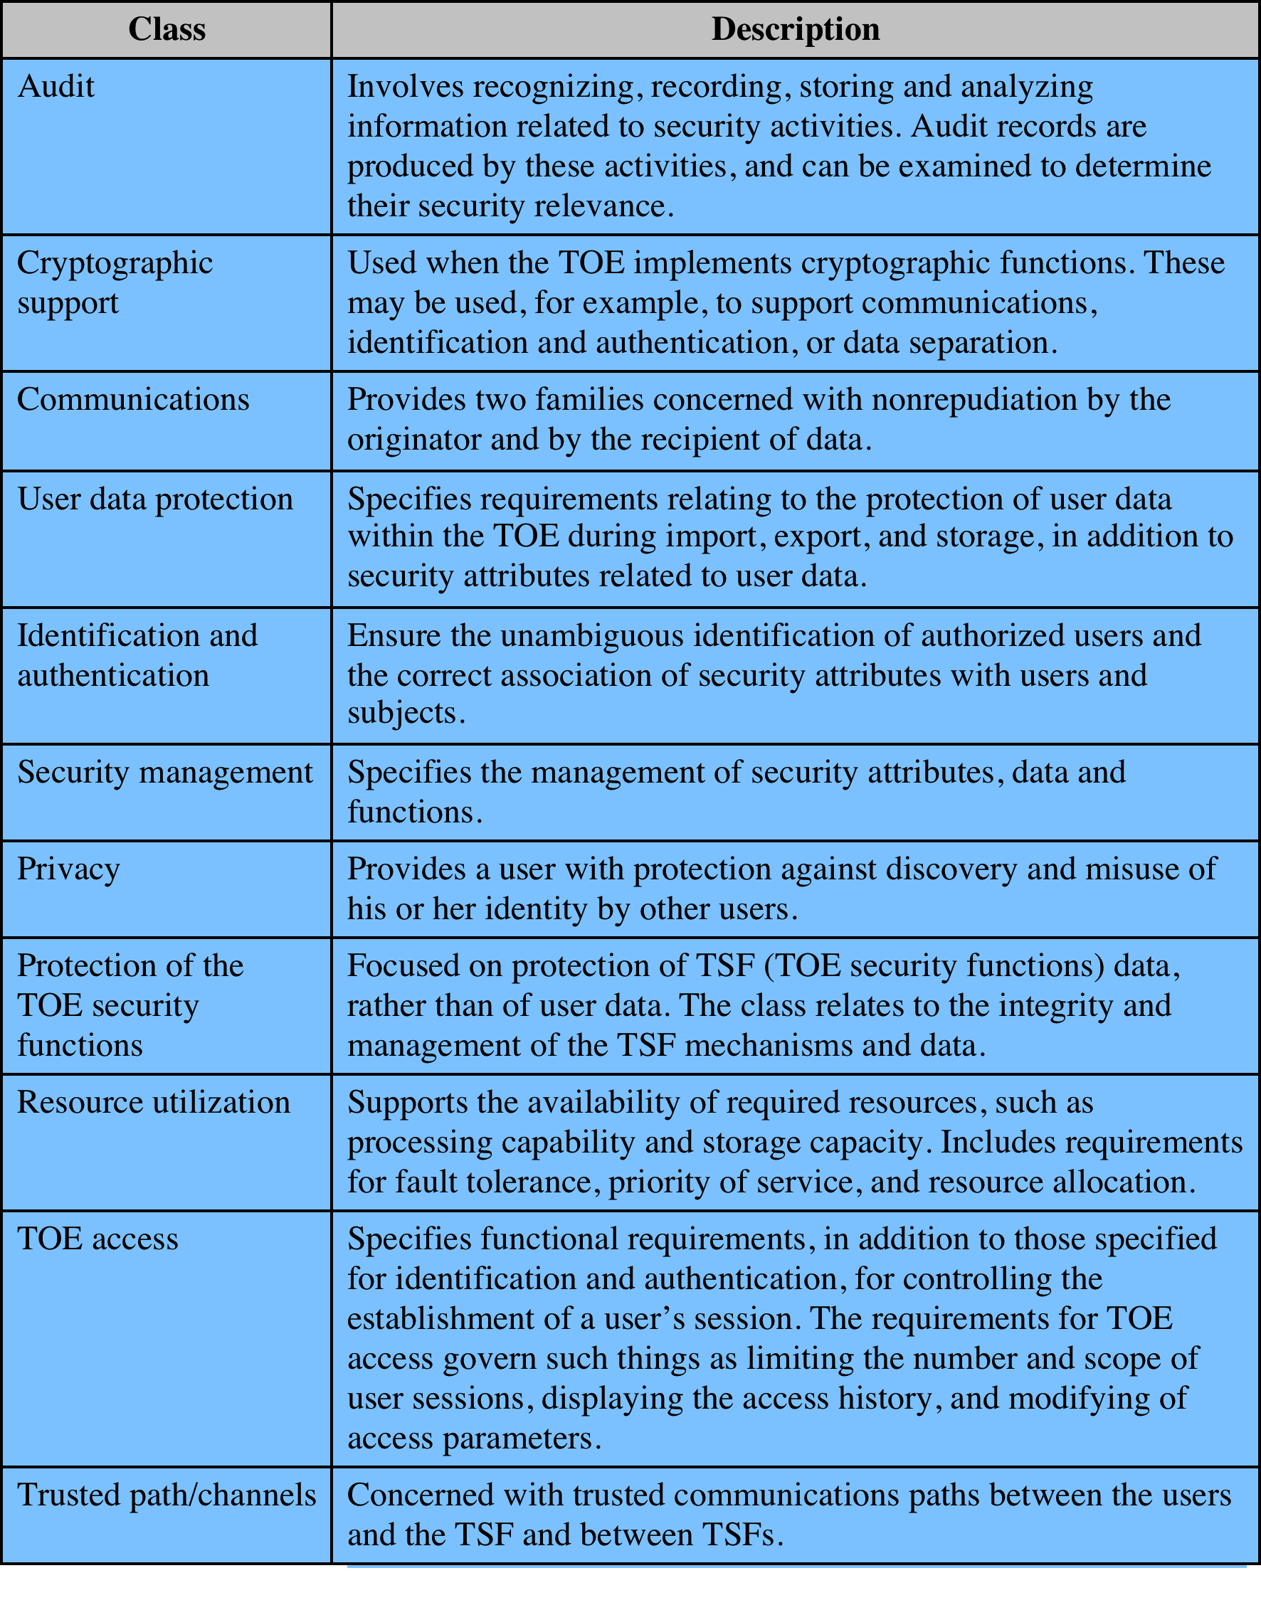
Table 13.3
CC Security
Functional
Requirements
Notes:
Table 13.3 briefly defines the functional requirements.
In the area of
security functional requirements , the PP defines 42 requirements from the available
classes of security functional requirements ( Table 13.3 ). For example, for security
auditing, the PP stipulates what the system must audit; what information must be
logged; what the rules are for monitoring, operating and protecting the logs; and so
on. Functional requirements are also listed from the other functional requirements
classes, with specific details for the smart card operation.

Slide 38
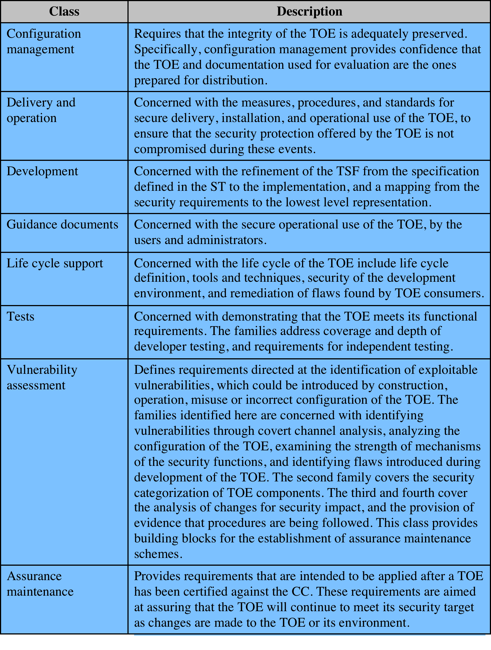
Table 13.4
CC Security
Assurance
Requirements
Notes:
Table 13.4 briefly defines the assurance requirements.
The PP defines 24 security assurance requirements from the available classes
of security assurance requirements ( Table 13.4 ). These requirements were chosen
to demonstrate
• The quality of the product design and configuration
• That adequate protection is provided during the design and implementation
of the product
• That vendor testing of the product meets specific parameters
• That security functionality is not compromised during product delivery
• That user guidance, including product manuals pertaining to installation,
maintenance and use, are of a specified quality and appropriateness.

Slide 39
Organization and Construction of CC Requirements
Notes:
The CC also defines two kinds of documents that can be generated using the
CC-defined requirements.
• Protection profiles (PPs): Define an implementation-independent set
of security requirements and objectives for a category of products or
systems that meet similar consumer needs for IT security. A PP is intended
to be reusable and to define requirements that are known to be useful and
effective in meeting the identified objectives. The PP concept has been
developed to support the definition of functional standards and as an aid
to formulating procurement specifications. The PP reflects user security
requirements.
Security targets (STs): Contain the IT security objectives and requirements
of a specific identified TOE and defines the functional and assurance
measures offered by that TOE to meet stated requirements. The ST may claim
conformance to one or more PPs and forms the basis for an evaluation. The ST
is supplied by a vendor or developer.
Figure 13.14 illustrates the relationship between requirements on the one
hand and profiles and targets on the other. For a PP, a user can select a number of
components to define the requirements for the desired product. The user may also
refer to predefined packages that assemble a number of requirements commonly
grouped together within a product requirements document. Similarly, a vendor or
designer can select a number of components and packages to define an ST.

Slide 40
Protection Profile (PP)
smart card provides simple PP example
describes IT security requirements for smart card use by sensitive applications
threats that must be addressed:
physical probing
invalid input
linkage of multiple operations
security objectives
reflect the stated intent to counter identified threats and comply with identified organizational security policies
security requirements
provided to thwart specific threats and to support specific policies under specific assumptions
Notes:
The protection profile for a smart card, developed by the Smart Card Security
User Group, provides a simple example of a PP. This PP describes the IT security
requirements for a smart card to be used in connection with sensitive applications,
such as banking industry financial payment systems. The assurance level for this
PP is EAL 4, which is described in the following subsection. The PP lists threats
that must be addressed by a product that claims to comply with this PP. The threats
include the following:
• Physical probing: May entail reading data from the TOE through techniques
commonly employed in IC failure analysis and IC reverse engineering efforts.
• Invalid input: Invalid input may take the form of operations that are not formatted
correctly, requests for information beyond register limits, or attempts
to find and execute undocumented commands. The result of such an attack
may be a compromise in the security functions, generation of exploitable errors
in operation, or release of protected data.
• Linkage of multiple operations: An attacker may observe multiple uses of
resources or services and, by linking these observations, deduce information
that that may reveal security function data.
Following a list of threats, the PP turns to a description of security objectives .
These reflect the stated intent to counter identified threats and/or comply with any
organizational security policies identified. Nineteen objectives are listed, including
the following:
Audit: The system must provide the means of recording selected security relevant
events, so as to assist an administrator in the detection of potential
attacks or misconfiguration of the system security features that would leave it
susceptible to attack.
• Fault insertion: The system must be resistant to repeated probing through
insertion of erroneous data.
• Information leakage: The system must provide the means of controlling and
limiting the leakage of information in the system so that no useful information
is revealed over the power, ground, clock, reset, or I/O lines.
Security requirements are provided to thwart specific threats and to support
specific policies under specific assumptions. The PP lists specific requirements in
three general areas: TOE security functional requirements, TOE security assurance
requirements, and security requirements for the IT environment.
The PP also lists security requirements of the IT environment . These cover the
following topics:
• Cryptographic key distribution
• Cryptographic key destruction
• Security roles
The final section of the PP (excluding appendices) is a lengthy rationale for
all of the selections and definitions in the PP. The PP is an industry-wide effort
designed to be realistic in its ability to be met by a variety of products with a variety
of internal mechanisms and implementation approaches.

Slide 41
Security
Assurance
“…degree of confidence that the security controls operate correctly and protect the system as intended. Assurance is not, however, an absolute guarantee that the measures work as intended.”
Notes:
The NIST Computer Security Handbook [NIST95] characterizes assurance in the
following way: “Security assurance is the degree of confidence one has that the
security controls operate correctly and protect the system as intended. Assurance
is not, however, an absolute guarantee that the measures work as intended.” As
with any other aspect of computer security, resources devoted to assurance must be
subjected to some sort of cost-benefit analysis to determine what amount of effort is
reasonable for the level of assurance desired.

Slide 42
Assurance and Evaluation
target audiences:
  assurance
  deals with security features of IT products
  applies to:
    requirements
    security policy
    product design
    product implementation
    system operation
consumers
select security features and functions
determine the required levels of security assurance
developers
respond to security requirements
interpret statements of assurance requirements
determine assurance approaches and level of effort
evaluators
use the assurance requirements as criteria when evaluating security features and controls
may be in the same organization as consumers or a third-party evaluation team
Notes:
The design of assurance measures depends in part on the target audience
for these measures. That is, in developing a degree of confidence in security
measures, we need to specify what individuals or groups possess that degree of
confidence. The CC document on assurance [CCPS09c] lists the following target
audiences:
• Consumers: Select security features and functions for a system and determine
the required levels of security assurance.
• Developers: Respond to actual or perceived consumer security requirements;
interpret statements of assurance requirements; and determine assurance
approaches and level of effort.
Evaluators: Use the assurance requirements as a mandatory statement of
evaluation criteria when evaluating security features and controls.
Evaluators may be in the same organization as consumers or a third-party
evaluation team.
Assurance deals with security features of IT products, such as computers, database
management systems, operating systems, and complete systems. Assurance applies
to the following aspects of a system:
• Requirements: This category refers to the security requirements for a product
• Security policy: Based on the requirements, a security policy can be defined
• Product design: Based on requirements and security policy
• Product implementation: Based on design
• System operation: Includes ordinary use plus maintenance
In each area, various approaches can be taken to provide assurance. [CCPS09c]
lists the following possible approaches:
• Analysis and checking of process(es) and procedure(s)
• Checking that process(es) and procedure(s) are being applied
• Analysis of the correspondence between TOE design representations
• Analysis of the TOE design representation against the requirements
• Verification of proofs
• Analysis of guidance documents
• Analysis of functional tests developed and the results provided
• Independent functional testing
• Analysis for vulnerabilities (including flaw hypothesis)
• Penetration testing

Slide 43
Scope of Assurance
system architecture
addresses both the system development phase and the system operations phase
system integrity
addresses the correct operation of the system hardware and firmware
system testing
ensures security features have been tested thoroughly
design specification and verification
addresses the correctness of the system design and implementation with respect to the system security policy
covert channel analysis
attempts to identify any potential means for bypassing security policy
trusted facility management
deals with system administration
trusted recovery
provides for correct operation of security features after a system recovers from failures, crashes, or security incidents
trusted distribution
ensures that protected hardware, firmware, and software do not go through unauthorized modification during transit from the vendor to the customer
configuration management
requirements are included for configuration control, audit, management, and accounting
Notes:
A somewhat different take on the elements of assurance is provided in
[CHOK92]. This report is based on experience with Orange Book evaluations but
is relevant to current trusted product development efforts. The author views assurance
as encompassing the following requirements:
• System architecture: Addresses both the system development phase and the
system operations phase. Examples of techniques for increasing the level of
assurance during the development phase include modular software design,
layering, and data abstraction/information hiding. An example of the operations
phase is isolation of the trusted portion of the system from user processes.
• System integrity: Addresses the correct operation of the system hardware and
firmware and is typically satisfied by periodic use of diagnostic software.
• System testing: Ensures that the security features have been tested thoroughly.
This includes testing of functional operations, testing of security requirements,
and testing of possible penetrations.
Design specification and verification: Addresses the correctness of the system
design and implementation with respect to the system security policy. Ideally,
formal methods of verification can be used.
• Covert channel analysis: This type of analysis attempts to identify any potential
means for bypassing security policy and ways to reduce or eliminate such
possibilities.
• Trusted facility management: Deals with system administration. One approach
is to separate the roles of system operator and security administrator. Another
approach is detailed specification of policies and procedures with mechanisms
for review.
• Trusted recovery: Provides for correct operation of security features after a
system recovers from failures, crashes, or security incidents.
• Trusted distribution: Ensures that protected hardware, firmware, and software
do not go through unauthorized modification during transit from the
vendor to the customer.
• Configuration management: Requirements are included for configuration
control, audit, management, and accounting.
Thus we see that assurance deals with the design, implementation, and operation
of protected resources and their security functions and procedures. It is important
to note that assurance is a process, not an attainment. That is, assurance must be an
ongoing activity, including testing, auditing, and review.

Slide 44
CC Assurance Levels
EAL 1 - functionally tested
EAL 2: structurally tested
EAL 3: methodically tested and checked
EAL 4: methodically designed, tested, and reviewed
EAL 5: semi-formally designed and tested
EAL 6: semi-formally verified design and tested
EAL 7: formally verified design and tested
Notes:
The concept of evaluation assurance is a difficult one to pin down. Further, the degree
of assurance required varies from one context and one functionality to another. To
structure the need for assurance, the CC defines a scale for rating assurance consisting
of seven evaluation assurance levels (EALs) ranging from the least rigor and
scope for assurance evidence (EAL 1) to the most (EAL 7). The levels are as follows:
• EAL 1: functionally tested: For environments where security threats are not
considered serious. It involves independent product testing with no input
from the product developers. The intent is to provide a level of confidence in
correct operation.
• EAL 2: structurally tested: Includes a review of a high-level design provided
by the product developer. Also, the developer must conduct a vulnerability
analysis for well-known flaws. The intent is to provide a low to moderate level
of independently assured security.
• EAL 3: methodically tested and checked: Requires a focus on the security
features. This includes requirements that the design separate security-related
components from those that are not; that the design specifies how security
is enforced; and that testing be based both on the interface and the high level
design, rather than a black-box testing based only on the interface. It
is applicable where the requirement is for a moderate level of independently
assured security, with a thorough investigation of the TOE and its development
without incurring substantial reengineering costs.
EAL 4: methodically designed, tested, and reviewed: Requires a low-level as
well as a high-level design specification. Requires that the interface specification
be complete. Requires an abstract model that explicitly defines security
for the product. Requires an independent vulnerability analysis. It is applicable
in those circumstances where developers or users require a moderate
to high level of independently assured security in conventional commodity
TOEs, and there is willingness to incur some additional security-specific
engineering costs.
• EAL 5: semi-formally designed and tested: Provides an analysis that includes
all of the implementation. Assurance is supplemented by a formal model and
a semiformal presentation of the functional specification and high-level design
and a semiformal demonstration of correspondence. The search for vulnerabilities
must ensure resistance to penetration attackers with a moderate attack
potential. Covert channel analysis and modular design are also required.
• EAL 6: semi-formally verified design and tested: Permits a developer to gain
high assurance from application of specialized security engineering techniques
in a rigorous development environment, and to produce a premium TOE for
protecting high value assets against significant risks. The independent search
for vulnerabilities must ensure resistance to penetration attackers with a high
attack potential.
• EAL 7: formally verified design and tested: The formal model is supplemented
by a formal presentation of the functional specification and high level
design, showing correspondence. Evidence of developer “white box” testing
of internals and complete independent confirmation of developer test results
are required. Complexity of the design must be minimized.
The first four levels reflect various levels of commercial design practice. Only
at the highest of these levels (EAL 4) is there a requirement for any source code
analysis, and this only for a portion of the code. The top three levels provide specific
guidance for products developed using security specialists and security-specific
design and engineering approaches.

Slide 45

Evaluation
ensures security features work correctly and effectively and show no exploitable vulnerabilities
performed in parallel with or after the development of the TOE
higher levels entail: greater rigor, more time, more cost
principle input: security target, evidence, actual TOE
result: confirm security target is satisfied for TOE
process relates security target to high-level design, low-level design, functional specification, source code implementation, and object code and hardware realization of the TOE
degree of rigor and depth of analysis are determined by assurance level desired
Notes:
The aim of evaluating an IT product, a TOE, against a trusted computing standard
is to ensure that the security features in the TOE work correctly and effectively, and
that show no exploitable vulnerabilities. The evaluation process is performed either in
parallel with, or after, the development of the TOE, depending on the level of assurance
required. The higher the level, the greater the rigor needed by the process and
the more time and expense that it will incur. The principle inputs to the evaluation are
the security target, a set of evidence about the TOE, and the actual TOE. The desired
result of the evaluation process is to confirm that the security target is satisfied for the
TOE, confirmed by documented evidence in the technical evaluation report.
The evaluation process will relate the security target to one or more of the
high-level design, low-level design, functional specification, source code implementation,
and object code and hardware realization of the TOE. The degree of rigor
used, and the depth of analysis are determined by the assurance level desired for the
evaluation. At the higher levels, semiformal or formal models are used to confirm
that the TOE does indeed implement the desired security target. The evaluation
process also involves careful testing of the TOE to confirm it’s security features.

Slide 46
Evaluation Parties and Phases
evaluation parties:
  sponsor - customer or vendor
  developer - provides evidence for evaluation
  evaluator - confirms requirements are satisfied
  certifier - agency monitoring evaluation process
monitored and regulated by a government agency in each country
Common Criteria Evaluation and Validation Scheme (CCEVS)
  operated by NIST and the NSA
preparation:
initial contact between sponsor and developer
conduct of evaluation:
confirms satisfaction of security target
conclusion:
final report is given to the certifiers for acceptance
Phases
Notes:
The evaluation involves a number of parties:
• Sponsor: Usually either the customer or the vendor of a product for which
evaluation is required. Sponsors determine the security target that the product
has to satisfy.
• Developer: Has to provide suitable evidence on the processes used to design,
implement, and test the product to enable its evaluation.
• Evaluator: Performs the technical evaluation work, using the evidence supplied
by the developers, and additional testing of the product, to confirm that it satisfies
the functional and assurance requirements specified in the security target.
In many countries, the task of evaluating products against a trusted computing
standard is delegated to one or more endorsed commercial suppliers.
• Certifier: The government agency that monitors the evaluation process and
subsequently certifies that a product as been successfully evaluated. Certifiers
generally manage a register of evaluated products, which can be consulted by
customers.
The evaluation process has three broad phases:
1. Preparation: Involves the initial contact between the sponsor and developers of
a product, and the evaluators who will assess it. It will confirm that the sponsor
and developers are adequately prepared to conduct the evaluation and will
include a review of the security target and possibly other evaluation deliverables.
It concludes with a list of evaluation deliverables and acceptance of the
overall project costing and schedule.
2. Conduct of evaluation: A structured and formal process in which the evaluators
conduct a series of activities specified by the CC. These include reviewing
the deliverables provided by the sponsor and developers, and other tests
of the product, to confirm it satisfies the security target. During this process,
problems may be identified in the product, which are reported back to the
developers for correction.
3. Conclusion: The evaluators provide the final evaluation technical report to
the certifiers for acceptance. The certifiers use this report, which may contain
confidential information, to validate the evaluation process and to prepare a
public certification report. The certification report is then listed on the relevant
register of evaluated products.
The evaluation process is normally monitored and regulated by a government
agency in each country. In the United States the NIST and the NSA jointly operate
the Common Criteria Evaluation and Validation Scheme (CCEVS). Many countries
support a peering arrangement, which allows evaluations performed in one country
to be recognized and accepted in other countries. Given the time and expense that
an evaluation incurs, this is an important benefit to vendors and consumers. The
Common Criteria Portal provides further information on the relevant agencies and
processes used by participating countries.

