Slide 1
Network design Worms
(plus we’ll start with some notes that will prove useful on lab 3)

Slide 2
Next lab: Implementing ARP Poisoning
ARP Poisoning sets the network up for a man-in-the-middle attack: once you have everyone talking to your computer, you can intercept and modify traffic at will
Tools in our next lab: On Deter, we will use tcpdump to monitor traffic and ettercap to sniff and filter content from the network

Slide 3
Tcpdump
Free linux command line tool that dumps all traffic from a network interface.
Other tools do exist. Wireshark, for example, is a free graphics based client much like tcpdump.
Must be run as root (or admin privileges).
With a hub (or wireless network), will see all traffic; on a switched network, will see all traffic routed to your machine
Good tutorial: http://danielmiessler.com/study/tcpdump

Slide 4
Tcpdump example

Slide 5
Huh? (Look closer)

Slide 6
And here:

Slide 7
Ettercap
Multipurpose sniffer and content filter for “network management” (i.e. man-in-the-middle attacks).
See http://linux.die.net/man/8/ettercap
You can use ettercap simply to sniff, but also to automatically apply filters to content being sent.

Slide 8
Ettercap example 1: Observe traffic between two machines

Slide 9
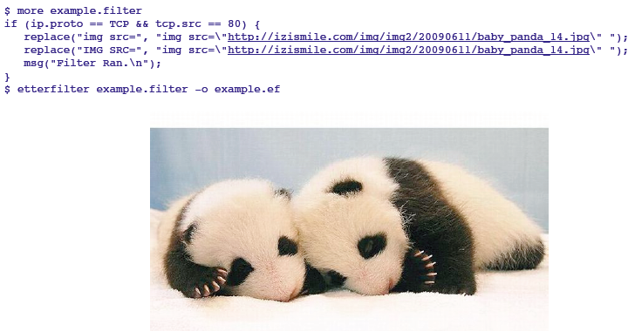
Ettercap example 2: Alter web traffic
Step 1: write a filter and compile it.

Slide 10
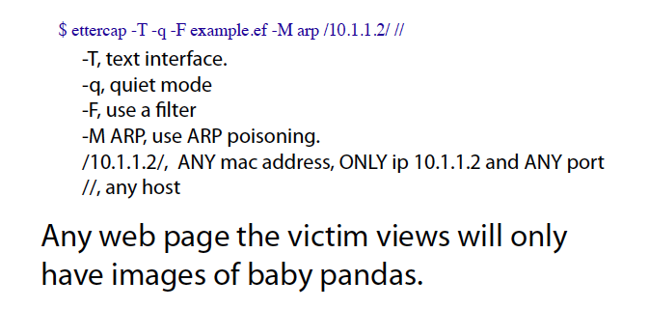
Ettercap example 2: Alter web traffic
Step 2: run ettercap

Slide 11
Beyond ARP poisoning
Once you have the basic setup, still need to conduct man-in-the-middle attack
ARP poisoning lets you eavesdrop, but what if the traffic is encrypted?

Slide 12
Recall: Key exchanges
Simple protocol:
Alice sends her public key to Bob.
Bob sends his public key to Alice.
Alice encrypts message with Bob’s public key, so Bob can decrypt with his private key.
Bob encrypts with Alice’s public key, and she can then decrypt with her own private key.

Slide 13
Recall: Key exchanges
Exploiting the simple protocol:
When Alice sends her public key to Bob, Eve intercepts and sends along her own public instead.
(Likewise for Bob’s public key.)
When Alice sends a message to Bob, Eve is able to decrypt it. She can then send it along to Bob (encrypted with her own key, which Bob thinks is Alice’s), or can replace it with a new one.
(Likewise for a message from Bob to Alice.)

Slide 14
Avoiding this attack
Simple key exchange: “A common cryptographic technique is to encrypt each individual conversation with a session key.” --Applied Cryptography by Schneier
Alice gets Bob’s public key from a distribution center
Alice generates a random session key, encrypts it with Bob’s public key, and sends it.
Bob decrypts Alice’s message using his private key
Both can then use the session key to encrypt.

Slide 15
Example: TSL (in web apps)

Slide 16
Note: still not foolproof!
At Black Hat DC 2009, for example, Moxie Marlinspike announced a security hold in one kind of certificate used I the SSL and TSL protocols.
His attack adds a null string character to a certificate field, which tricks the programs into recognizing a domain (incorrectly).

Slide 17
SSLstrip
He developed and now distributes a tool called SSL strip – essentially a simple python script to install the tool.
See the download page for details: http://www.thoughtcrime.org/software/sslstrip/
Given this (and other known issues), many think SSL has deep flaws in its structure, although it continues to be the industry leader.
We’ll talk more about it later when discussing web based attacks.

Slide 18
Network Design: A Case Study
Independent of all the low level (and important issues) we have been discussing, it may still be up to you to design a network for a corporation.
Infrastructure requirements and goals are a key point of the design:
Data should be confidential, and internal plans kept secret.
Releasing sensitive data should require approval.

Slide 19
Policy Design and Development
Goal is to develop security policies
Examine:
Internal organizations
Data classes
User classes
Infrastructure options or limitations

Slide 20
First principles:
Principle of Least Privilege: A subject should be given only those privileges that it needs to complete its task.
Principle of Open Design: The security of a mechanism should not depend on the secrecy of its design or implementation.

Slide 21
First principles:
Principle of Separation of Privilege: The system should not grant permission based on a single condition.
Principle of Fail-Safe Defaults: Unless a subject is given explicit access to an object, it should be denied access.

Slide 22
Example : a (fake) company

Slide 23
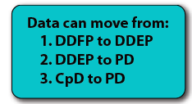
Example : a (fake) company

Slide 24
Fake Company (cont.)

Slide 25
Network Design Fundamentals
Most large scale networks have a “Demilitarized Zone” (DMZ):
A separate network between the purely internal network and the actual external internet
Two firewalls (one on each end), each with different sets of rules
Very few machines present; this is a place for services that need external access regularly, but actual workstations don’t fall into this category

Slide 26
Possible design for our company

Slide 27
A few things to note:

Slide 28
The outer firewall
Goals of the outer firewall:
“No read up”: restrict public access to the corporate network, which has sensitive data they do not have rights to access.
“No write down”: Restrict Dribble employee’s access to the internet, so that they cannot share sensitive data outside the company.

Slide 29
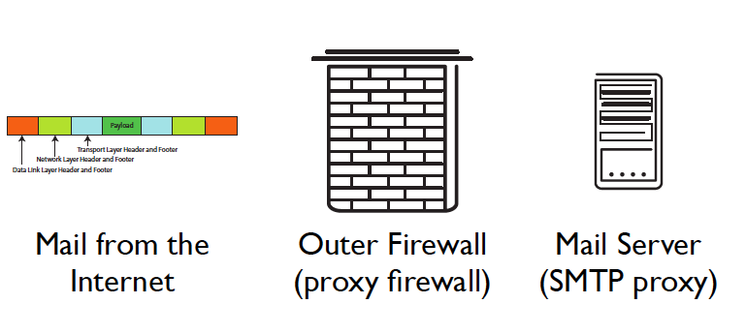
The outer firewall
Here, the company has decided that the outside network only needs access to the web server and the mail server.

Slide 30
The inner firewall
This firewall will block ALL traffic except:
SMTP connections (although all electronic mail goes through DMZ server)
System admins may access the DMZ computers from a trusted server only

Slide 31
Administrator connection
Uses SSH protocol
Inner firewall ensures that SSH can only go to the DMZ servers
SSH is set up at a trusted machine, so that we can ensure strong cryptographic authentication at both endpoints

Slide 33
DMZ Servers

Slide 34
DMZ Mail Server
Performs all checks and sanitization of email, and so removes burden for this from the firewall.
Reassembles messages
Scans letters and attachments
Destination addresses are rewritten to route mail to the internal mail server.
Also runs SSH server for admin access.

Slide 35
DMZ Web Server
Accepts and services requests and orders from the internet
When consumer data is entered, it is checked and then encoded immediately, and the original file is deleted.
Only the public key is on the web server.
No customer data is stored in clear text.
Also runs SSH server for admin connection.

Slide 36
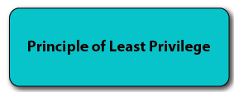
DMZ DNS Server
Has domain name service information for any hosts that the DMZ computers must know
DMZ mail, web, and log server
Internal trusted admin host
Outer firewall
Inner firewall
Does NOT know others (e.g. internal mail server)

Slide 37
DMZ log server
Performs administrative logging of network traffic or server info
Logs help to track data in case of attacks (although logs can be deleted)
Placed in the DMZ to limit its access
Accepts SSH connections from trusted admin host

Slide 38
Server Summary
In a nutshell, each server will have the minimum knowledge of the network necessary to perform its task
Operating systems for servers are kept very small, with only necessary services running

Slide 40
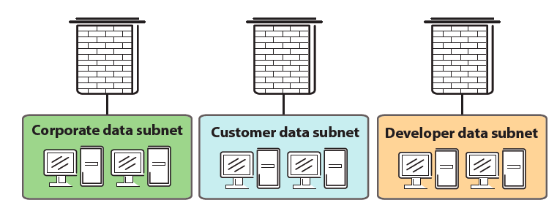
Internal networks
Each internal network has its own firewall

Slide 41
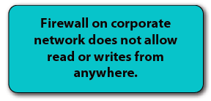
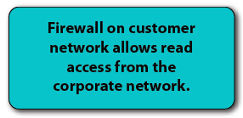
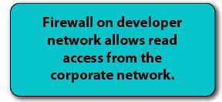
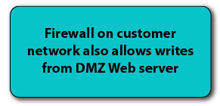

Slide 42
A few notes
This network is highly restrictive: note that NO internet connections other than email and customer web traffic is allowed to the internal network.
Note also that internal networks may have their own intranet services, such as chat servers, internal webpages, etc.

Slide 43
Additional DMZ services
Most DMZs incorporate intrusion detection systems to track connections
In addition, most companies have a web proxy server with caching in the DMZ to monitor, block, and speed up web browsing.
VPNs often also require a connection to the outside world, so support for these connections would reside in a DMZ

Slide 44
New topic: Malware
Many different types
Classified in two ways:
How it spreads or propagates
Actions it performs on a target
Generally, broad categories are virus versus worm
For now, we’ll focus on worms, which use network propagation as a key feature
(Viruses will come later…)

Slide 45
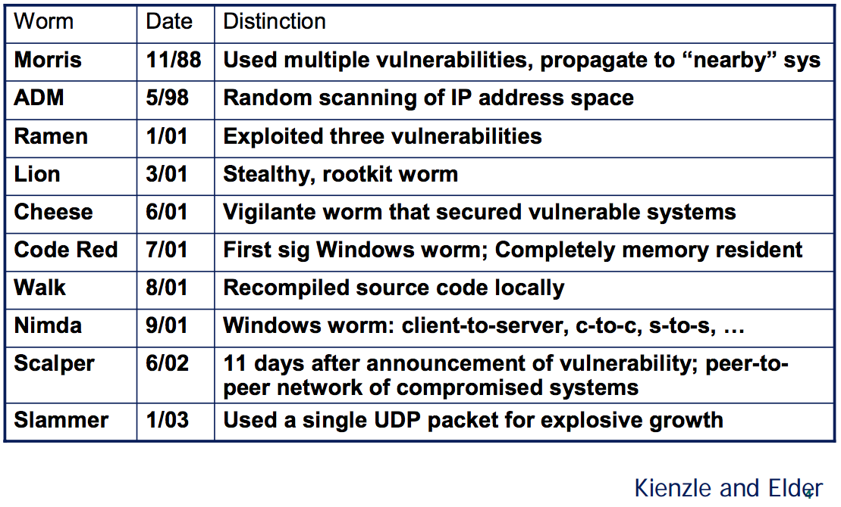
Worms: network based attacks
Tons of them!

Slide 46
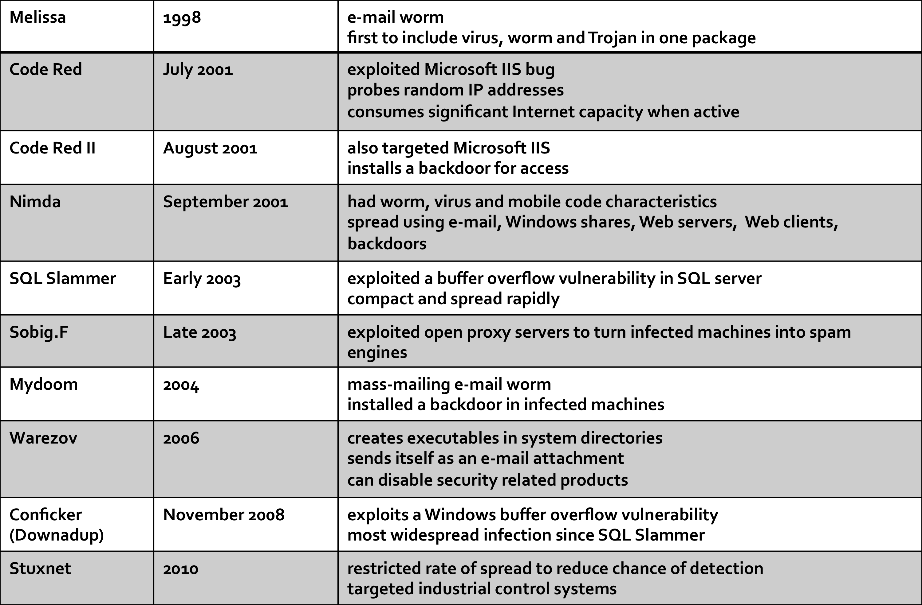
And even more of them:

Slide 47
How worms propagate
Scanning worms
Worm chooses “random” address
Coordinated scanning
Different worm instances scan different addresses
Flash worms
Assemble tree of vulnerable hosts in advance, propagate along tree
Meta-server worm
Ask server for hosts to infect (e.g., Google for “powered by phpbb”)
Topological worm:
Use information from infected hosts (web server logs, email address books, config files, SSH “known hosts”)
Contagion worm
Propagate parasitically along with normally initiated communication

Slide 48
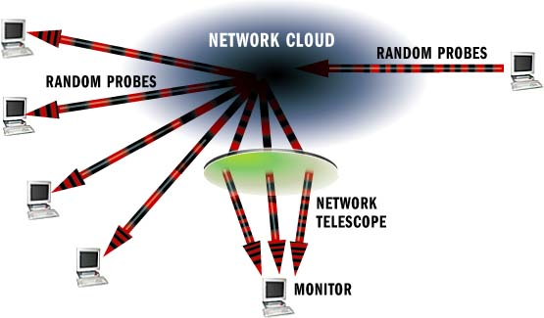
Measuring activity
Network telescopes:
Monitor a cross section of the internet address space
“Backscatter” from DOS floods
Attackers probing randomly
Scans from worms

Slide 49
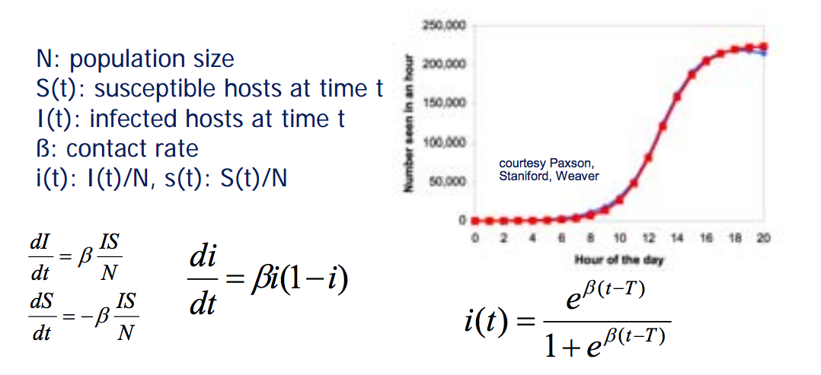
How fast are worms?
Model as an infectious epidemic

Slide 50
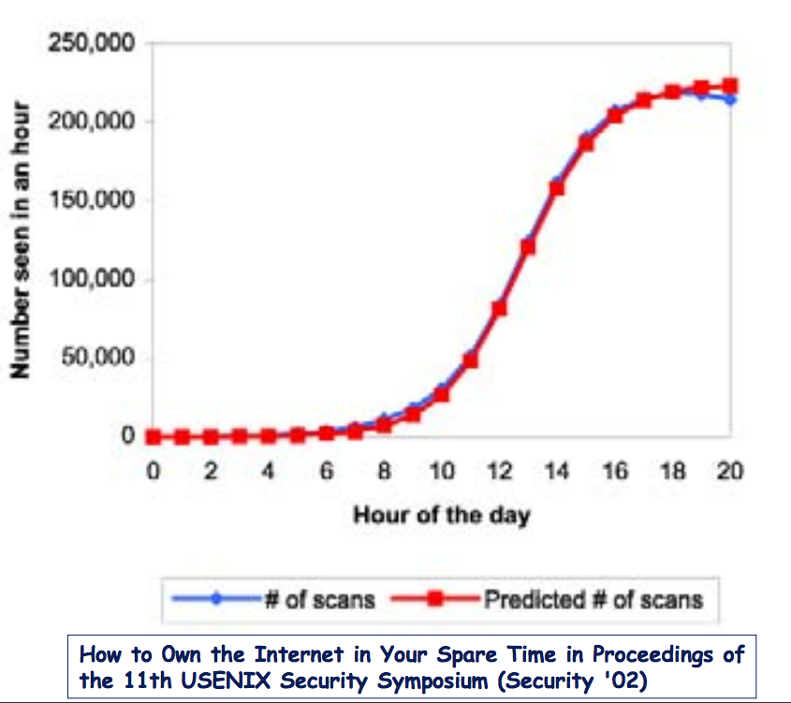
How accurate?
Code Red 1 Propagation
Count # of scans rather than number of hosts
Theory pretty close to what was observed

Slide 51
But depends on the worm
Slammer worm didn’t match theory
Fast propagating worms can encounter link bandwidth and latency constraints

Slide 52
Worm defenses
Detection of worms is via honeyfarms: collections of honeypots fed via a network telescope.
Any outbound connection will be a worm.
If telescope covers N addresses, expect detection when worm has infected 1/N of population
Detecting superspreaders
Hosts that make failed connection attempts to too many other hosts
Defense: throttling and rate limiting

Slide 53
Challenges for Worm defenses
There is a short interval between vulnerability disclosure and worm release
“zero-day” exploits are common
Worms go fast!
Slammer worm infection 90% of vulnerable hosts in 10 minutes
Large scale:
Slammer: 75,000 machines
CodeRed: 500,000 machines

Slide 54
Generic Exploit Blocking
Idea: Write a network IPS signature to detect and block all future attacks on a vulnerability
Different than writing for a specific exploit!
How:
Characterize vulnerability “shape”
Identify fields, services, or protocol states that must be present in attack traffic to exploit vulnerability
Identify data footprint size required to exploit it
Identify locality of footprint: local or spread through?
Write generic signature that can detect data that matches this “shape
This is like Shield research from Microsoft

Slide 55
Generic exploit blocking
An example:

Slide 56
Morris Worm
Infamous (and earliest) significant worm infection
Released by Robert Morris in 1988
Goal was actually to measure the internet
Written in 99 lines of C code, it was supposed to slowly make its way across the UNIX-based VAX and SUN machines on the ~60,000 large machine internet
Instead, it brought the entire internet screeching to a halt in less than 3 days.
Estimated that it took down 10% of the internet, and cost between $100,000 and $10,000,000 before it ended.

Slide 57
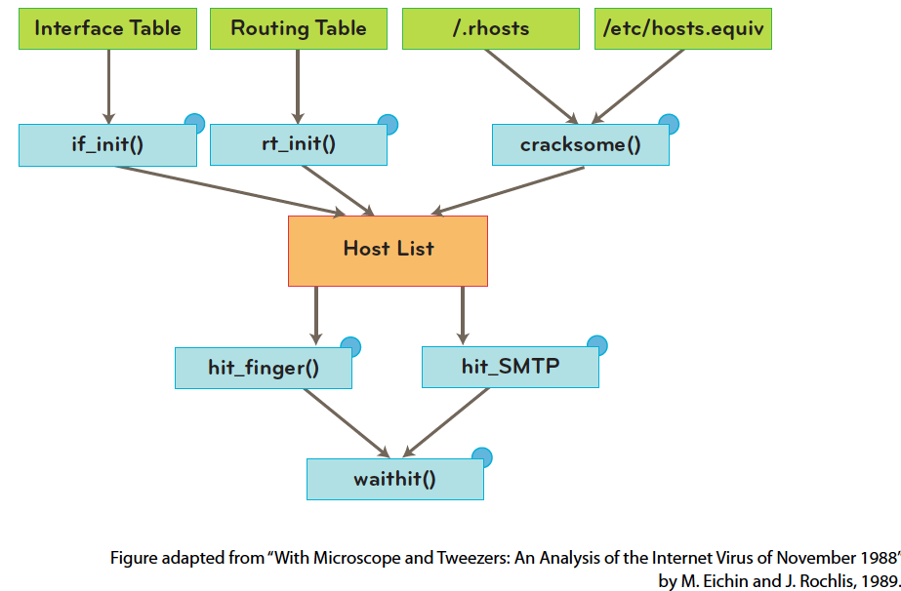
Morris worm: how?
Used 4 different attacks to propagate itself. We’ll examine a couple of them:

Slide 58
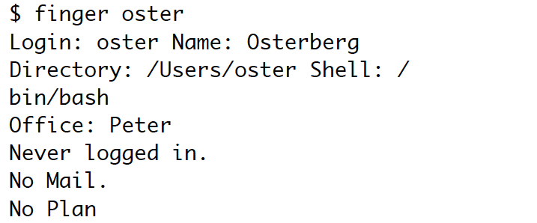
Finger
A UNIX server, used to provide information about a user at a remote host:

Slide 59
Finger weakness
Problem: Finger processes input using the C utility gets(). This function does not have bounds checking.
Essentially, this just means it doesn’t check to be sure you haven’t overrun the allocated space in the array that is set up for it.
(Remember when you ran off the end of your array in C++ in data structures? What happened?)

Slide 60
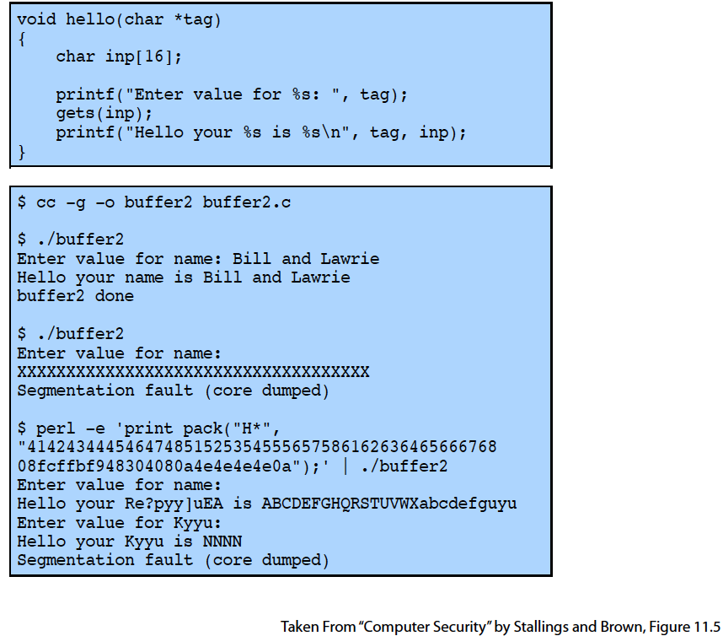
Example: gets()
C code with gets():

Slide 61
What is happening?

Slide 62
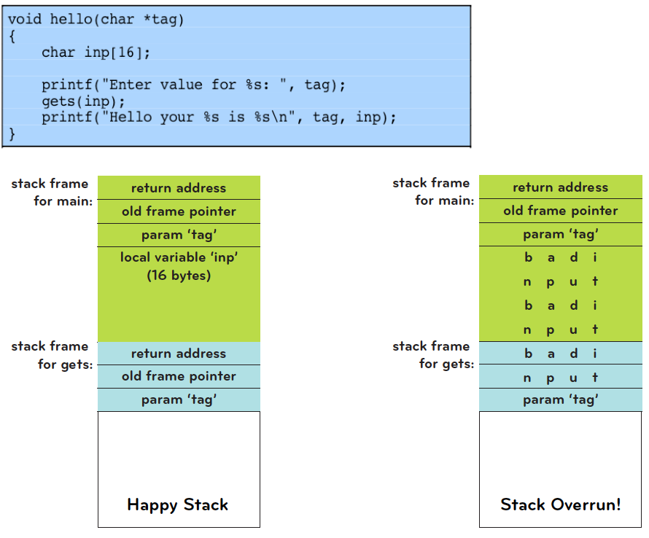
What is happening (cont)

Slide 63
What is happening (cont)

Slide 64
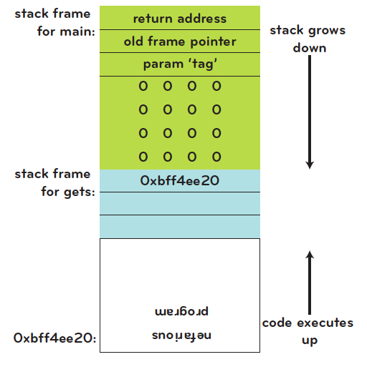
Even worse…
If one is clever, can actually execute a malicious program from the stack
This is called “smashing the stack”.
We say programs like this have “stack-based buffer overflow” problems. Unfortunately, very common in C code!

Slide 65
Back to finger
So, if someone called finger with a cleverly crafted argument, that someone could smash the stack and invoke another program
Like sh!
This is essentially one of the key components of the Morris worm.
And this is a teaser for a future lecture on buffer overflows, which we’ll look at more closely.
But first, one more vulnerability the Morris worm used to propagate…

Slide 66
Sendmail
Sendmail is a UNIX mail server
Early versions contained two “features”:
An outsider establishing an SMTP connection to the sendmail program could place sendmail in DEBUG mode
With DEBUG mode enabled, a user can execute the run command feature, which sends an email to a program. The program then uses the email as input.

Slide 67
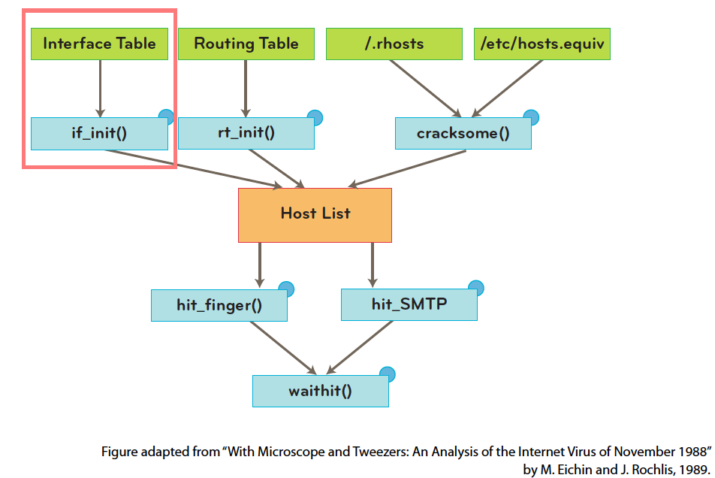
Back to the Morris worm
After initialization (and hiding itself), the worm calls if_init() routine which scans the network interfaces on that machine

Slide 68
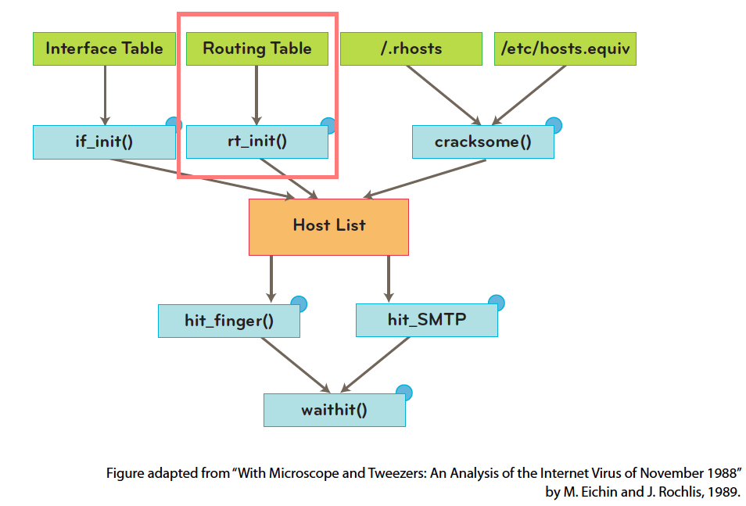
Next:
The machine then calls rt_init() to look up the machine’s routing table

Slide 69
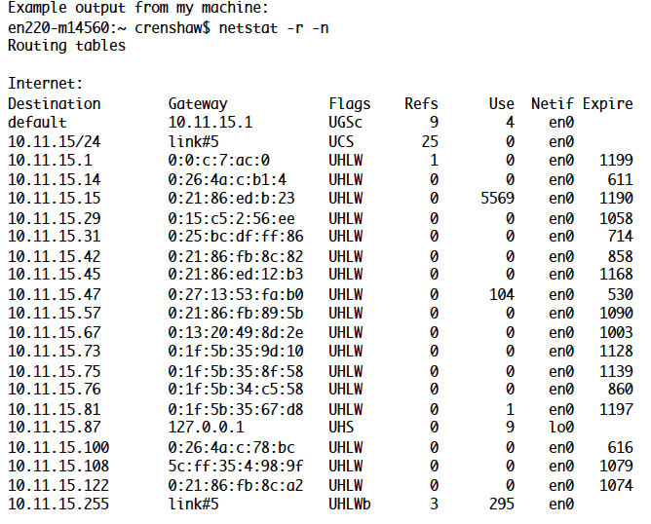
Using netstat
How? It calls netstat:
pipe=popen(“/usr/ucb/netstat –r –n”, “r”);

Slide 70
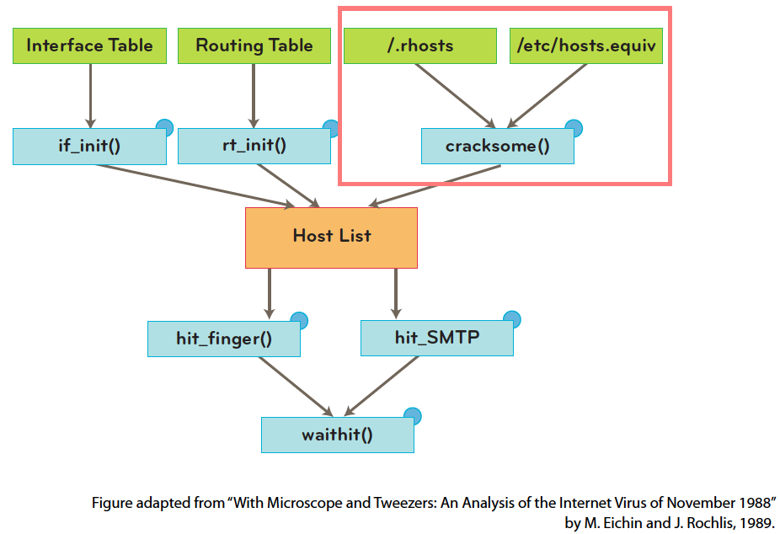
And next:
Then it calls cracksome() to find more machines that would be likely targets. (Both rhosts and rhosts.equiv list machines that the local machine knows and trusts.)

Slide 71
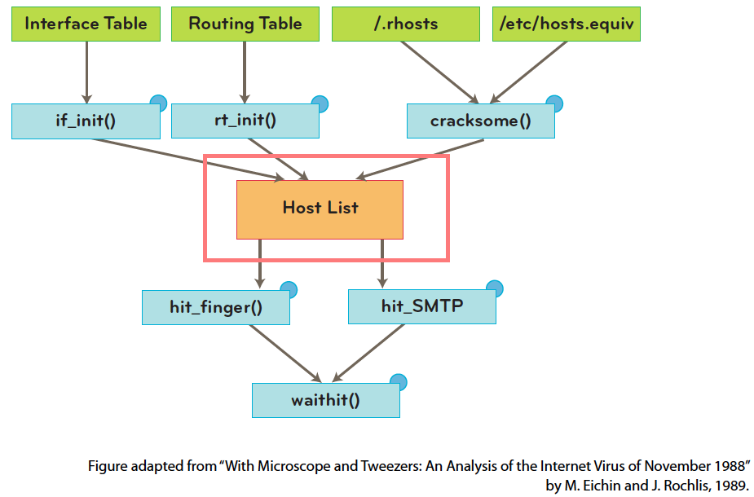
Targets are aquired
The worm now has a list of potential targets to attack.

Slide 72
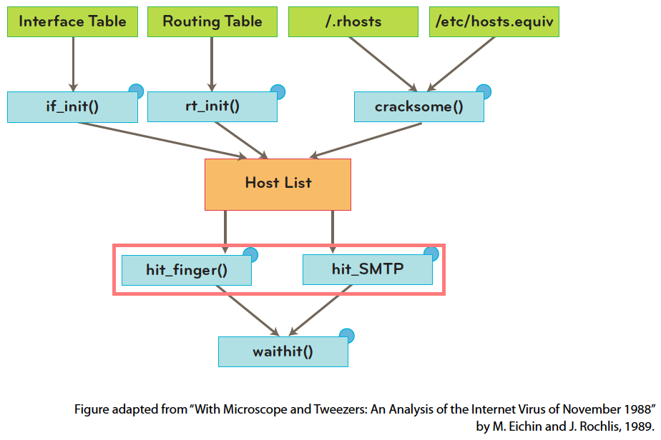
Attacking
It now tried to attack every host on this list using the finger exploit. If that fails, it tries the sendmail exploit.

Slide 73
Morris worm: next phase
Either way, a small program l1.c has hopefully been copied, compiled and launched at the remote host.
This is its “grappling hook”: a small piece of portable code that attempts to copy the full worm onto the new machine.
The final phase, waithit(), communicates with l1.c at the remote host to copy over a set of object files (the actual worm).

Slide 74
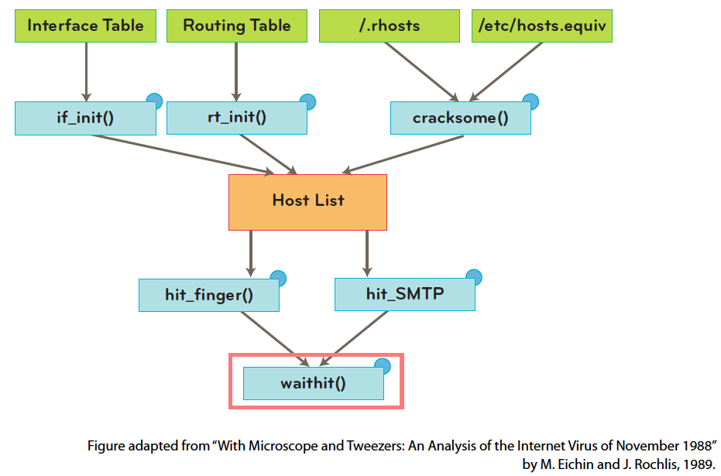
Morris worm: final phase
The object files are compiled for different targets. The program l1.c attempts to link and launch them on the target.

Slide 75
Morris worm: a mistake
You might be asking: how does this measure the internet??
Good question!
The worm was supposed to send a packet of data to 128.32.137.13, but the code had a bug. It never sent anything.
Also, the worm was supposed to detect if it was already running on the machine. However, in order to make it harder to detect later, it was set to run on the machine every 7 times. (Too much!)
Interestingly, it was released at MIT, even though Morris was a student at Cornell.

Slide 76
Morris worm: the aftermath
“Robert T. Morris was convicted of violating the Computer Fraud and Abuse Act (Title 18), and sentenced to 3 years of probation, 400 hours of community service, a fine of $10,050, and the costs of his supervision.”
He became a professor at MIT, conducting research in networks and OS.

Slide 77
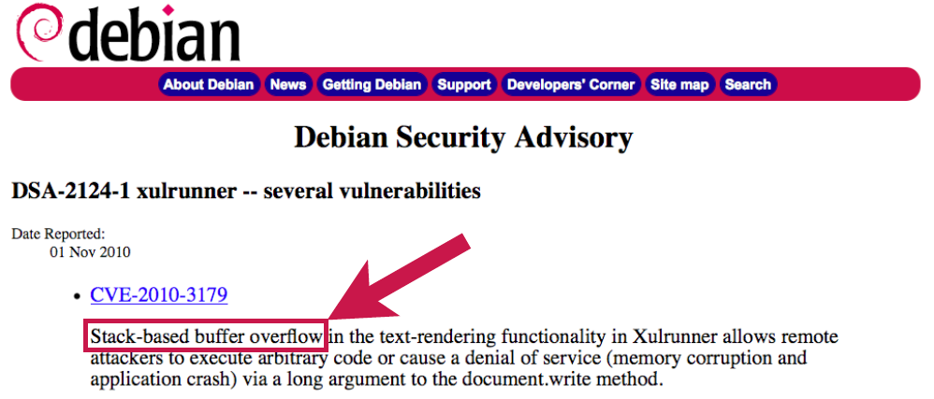
Why we care
It may seem silly to study such an old case – why should we care?
These same exploits (or similar ones) are still out there today!

Slide 78
Other Defenses
Many defenses have been enacted to stop the spread of worms. Main ones:
Firewalls
ASLR (Address Space Layout Randomization)
DEP (Data Execution Prevention) or Executable Address Space Protection
We’ll see these more later, but they are fairly strong, and there are many recent developments.

Slide 79
Botnet
Collection of compromised hosts
Spread like worms and viruses
Once installed, respond to remote commands
Platform for many network attacks
Spam forwarding
Click fraud
Keystroke logging
DDoS
Serious problems!
This is the top concern of many businesses like banks and online merchants

Slide 80
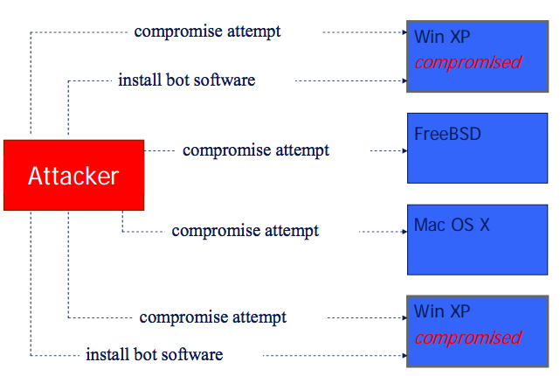
Building a botnet
Try different attacks:

Slide 81
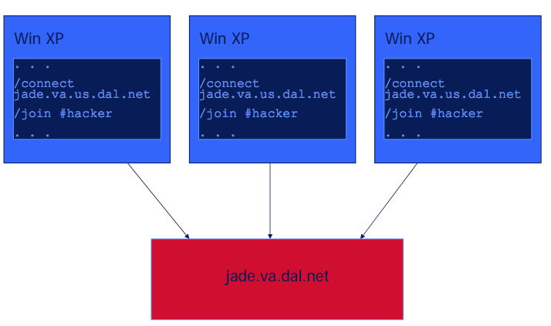
Building a botnet (cont)
Hosts then connect back:

Slide 82
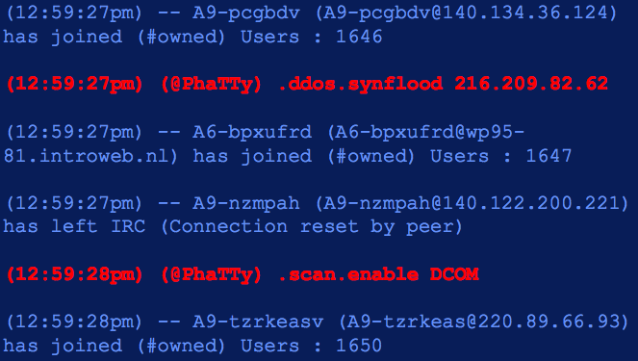
Building a botnet (cont)
And get instructions:

Slide 83
An example botnet: Storm email
Clicking on email or link caused malicious code to be installed
Fake news story on storm, ecard, links to malicious website
Incorporated a quick change to stay ahead of blocking: modified itself every 30 minutes to evade standard signature based monitoring
Infected 1.7 million bots by end of July
P2P architecture instead of centralized
For profit: it sent stock-picking spam, and ripped profits for the risen stocks

Slide 84
Bot detection methods
Signature based (and in most products)
Rule-based
Monitor outbound network connections (like ZoneAlarm) – generally annoying
Block certain ports
Hybrid approach: content based filtering
Match network packets to known command strings
Network monitoring
Bot hunter: correlate various NIDS alarms to identify infection sequence in progress
Recognize traffic patterns associated with infection

