Slide 1
CSCI 4650: Computer Security
Dr. Erin Wolf Chambers
Office: 301 Ritter Hall

Slide 2
Today’s overview and announcements:
Syllabus, plus lab overview
Essay 1 – due next week
Class enrollment (and if you aren’t registered…)
A few notes on ethics and computer security
Intro to computer security!

Slide 3
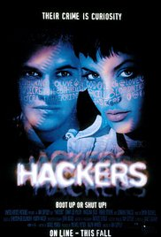
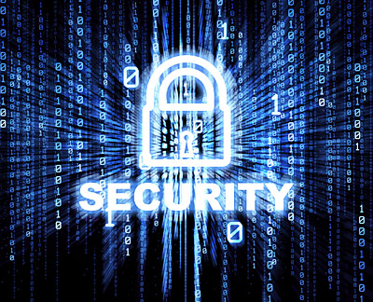
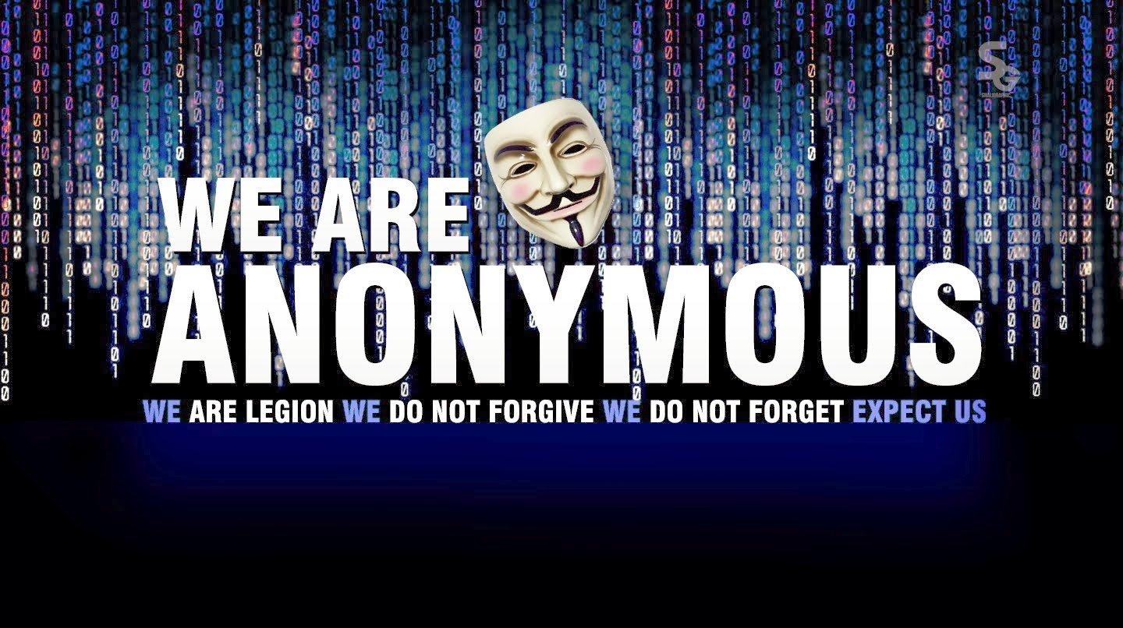
Computer Security: perception

Slide 4
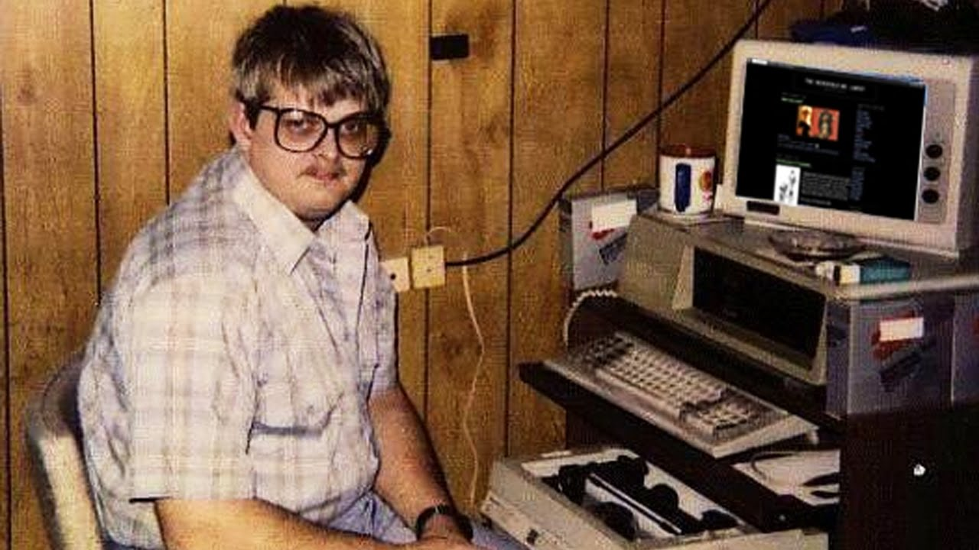
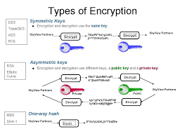
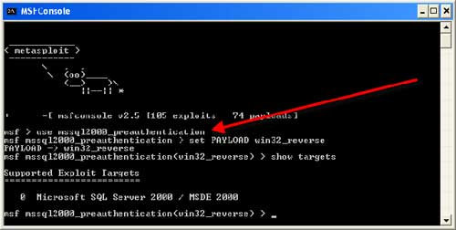
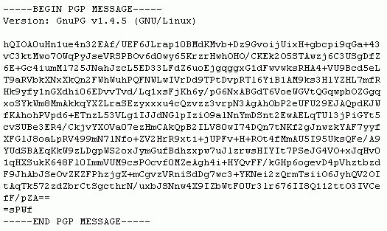
Computer security: reality

Slide 5
“Why computers are insecure”
In a famous essay, Bruce Schneier discusses if things will ever get better for computer security.
In a nutshell: no, because it is fundamentally harder to test if and how something can be broken than to test if something works.
“Satan’s computer is hard to test.”
Can’t just “try and fix”, which is what most software development does.

Slide 6
Our goals
Introduce both theory and practice of computer security.
You will be asked to attach and harden machines and software, in a linux environment.
You will also be required to write essays based on research articles, in order to strengthen clear communication of both opinions and facts.
Note: this is sometimes both more difficult and more essential in a career!

Slide 7
Why we should care

Slide 8
Why aren’t we more secure?
Technical issues, as well as cost/benefit analysis
Paying for true secure development is expensive!
Usually don’t really see the payoff
Users often perceive no personal threat, so little incentive to be careful
Generally, usability is harder as security increases.
Ignorance of real issues – many users don’t truly understand the technology
Legacy issues abound!

Slide 9
An example: firewire
Firewire is an interface used (mostly on macs) from 1999 to 2014
Extremely fast, since allowed high speed data transfer
The catch: speed comes because it allows direct access to memory, with no real access control by the OS.
Result: physical access + firewire means any computer can be hacked.
Could bypass lock screen and all OS security mechanisms.

Slide 10
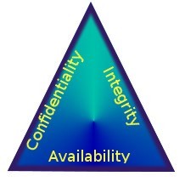
Basic issues:
We commonly break things down to 3 common issues (the CIA triad):
Confidentiality
Integrity
Availability
Designed to guide policies for information security within an organization.

Slide 11
Confidentiality
Essentially, this component is about privacy
Goal is to maintain access control over data.
This often involves classifying information into a hierarchy, and limiting access to those who are authorized to view it.
Often involves special training to identify risk factors, as well as basic education (i.e. passwords).
Tools: encryption, authentication, etc.

Slide 12
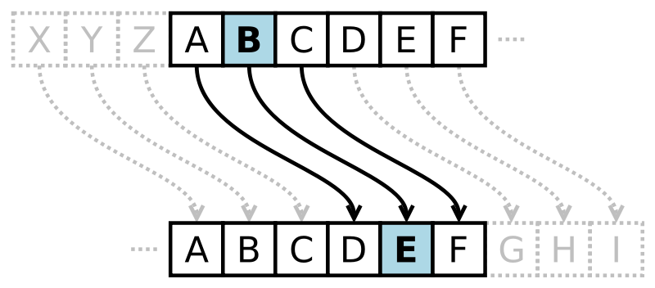
Confidentiality (cont.)
This one isn’t new: ever heard of a Caesar cipher?
Cryptography in general predates any notion of a computer….

Slide 13
Integrity
Integrity involves maintaining consistency and accuracy over the life cycle of the data.
Should not be changed in transit
Should not be altered by unauthorized people
Often involves some way to detect changes in the data, either from accidental or malicious causes.

Slide 14
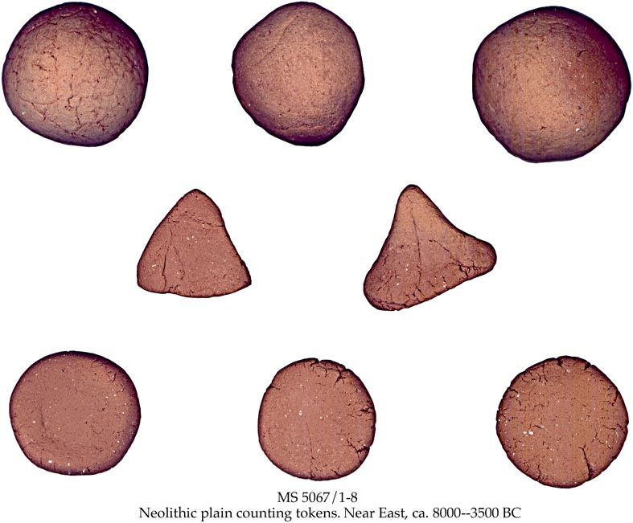
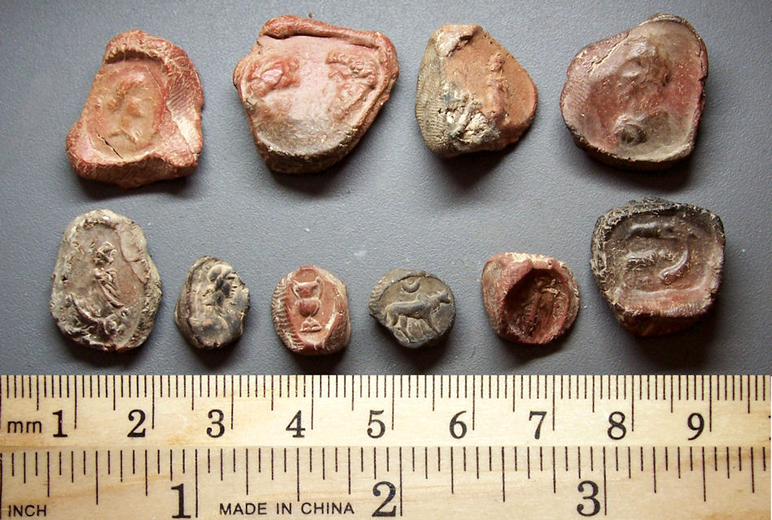
Integrity (cont)
This one also isn’t new!
One of the oldest problems out there: how can we be sure data is recorded and not altered by someone else?
Historically, this was done physically somehow.
Clay tables (8000-ish BC)
Double bookkeeping (12th century)

Slide 15
Availability
Goal is to give users access to information and systems at all times. This involves:
Keeping systems and software up to date and functioning correctly
Providing sufficient communication infrastructure
Redundancy in systems
Disaster recovery in the worst case

Slide 16
A note on ethical behavior
In this class, you will learn tools and techniques that DO involve breaking laws.
Labs are set up to give you hands on practice in a very safe setting.
Please do NOT use these tools elsewhere without explicit written permission of a sysadmin, and be careful about using them at home.
Above all, conduct yourself with integrity!
I am not your babysitter, but I am happy to discuss any questions that come up along the way.

Slide 17
Laws and computer security
At a cyberlaw conference in 1996, Judge Easterbrook argued against “cybercrime” as a field of legal studies
He used the term “law of the horse”: why should horses deserve their own field of legal studies?
In 1999, Dr. Lawrence Lessig wrote an article called “Law of the Horse”, in which he argued that computer security deserved its own field, by virtue of its unique domain and power.
He discussed the power of norms, codes, laws and the market on this field.

Slide 18
Norms and computers
Lessig also discussed norms that govern behavior – while not legally binding, they are very powerful:

Slide 19
Codes
Codes are perhaps the easiest to trace in computer science, as we are literally built on them:
ASCII
TCP/IP
Protocols
Behavior in computing systems is seriously constrained, or else nothing can get done.

Slide 20
Legal issues: some basics
Regardless of how, laws have become an extremely important thing for any computer security person to be aware of.
One of the first laws regarding computing systems was the Computer Fraud And Abuse Act (CFAA), passed in 1986.
Protects confidentiality of private information:
It is a crime to “knowingly access a computer without or in excess of authority to obtain classified information”.
It is a crime to access any “protected computer” without authorization even if no damage is done.

Slide 21
Market
Obviously, the market is a dominant force in computing (as in any industry).
However, digital issues can become more complex than in other areas, as digital content can control rights much differently:

Slide 22
Market (cont)
Eerily, this came up in 2008 when Amazon added several Orwell books to the kindle store.
They did not obtain proper rights to them.
Amazon deleted the works from the buyer’s library.
However, this deleted their own work, such as annotations, and was done without warning or consent.

Slide 23
Summary
We’ll be examining these issues more throughout the course; this lecture is just meant to introduce some common notions and discussion points.
First topic: cryptography and hashing
Reminder: first essay due next week, and next homework will be over crypto

